Slide 1

cBioPortal: data formats
Adria Closa,PhD
Bioinformatician & Data Steward
Department of Pathology
Translational Gastrointestional Oncology
The Netherlands Cancer Institute
a.c.mosquera@nki.nl
4 June 2025

Slide 2
Summary
cBioPortal data structure
Live demo: playing and testing a public study (TCGA)
cBioPortal data formatting card game

Slide 3
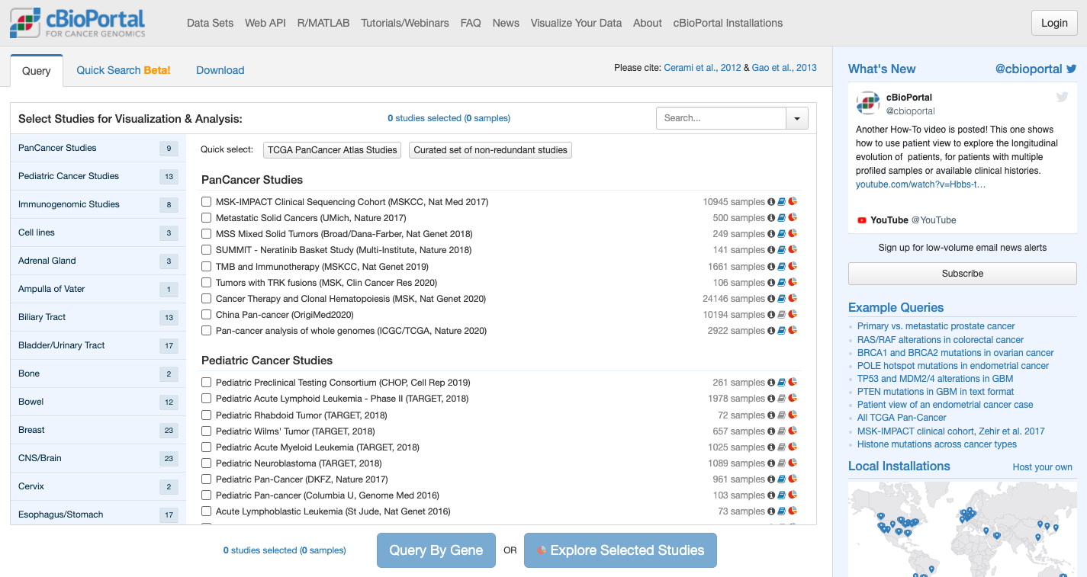
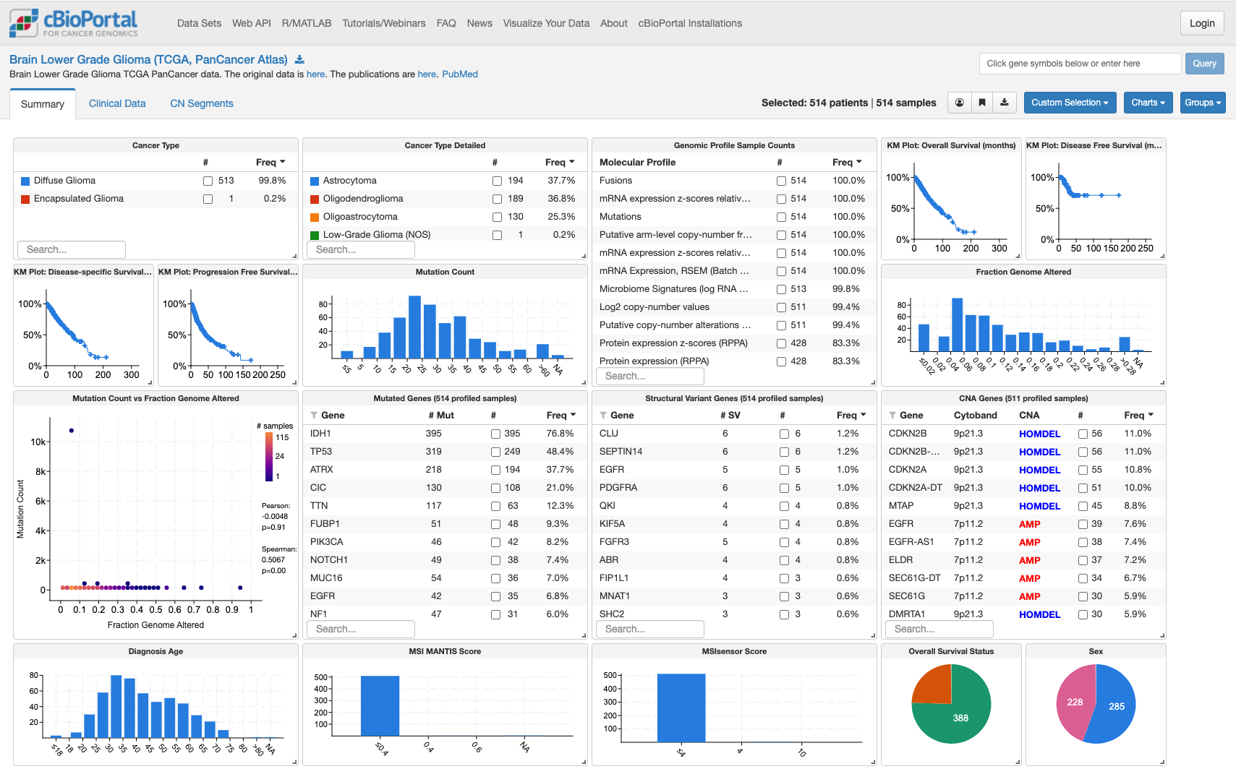
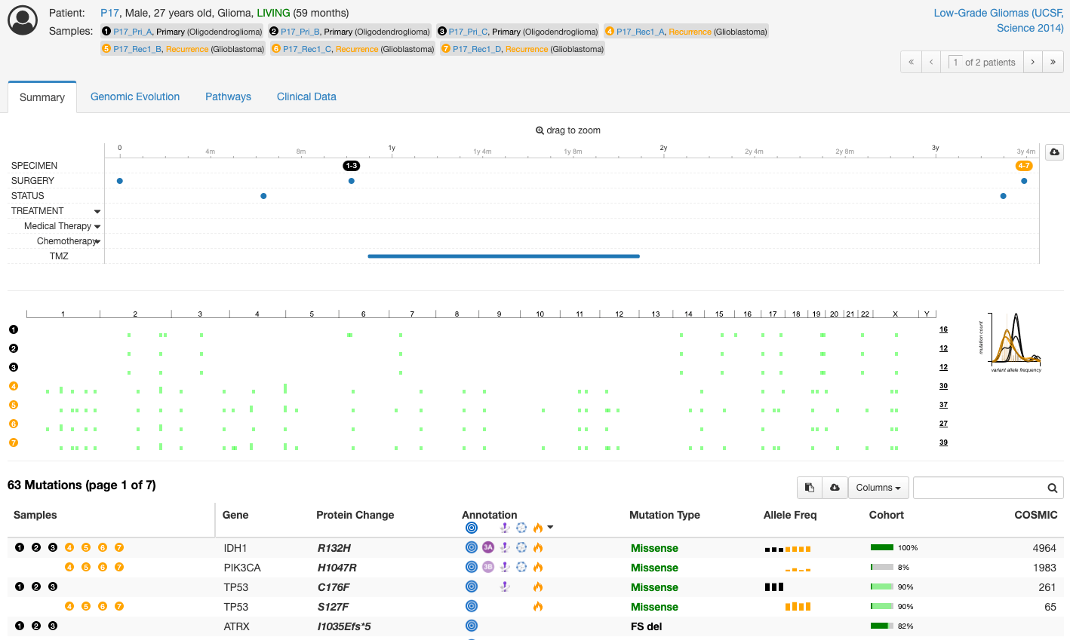
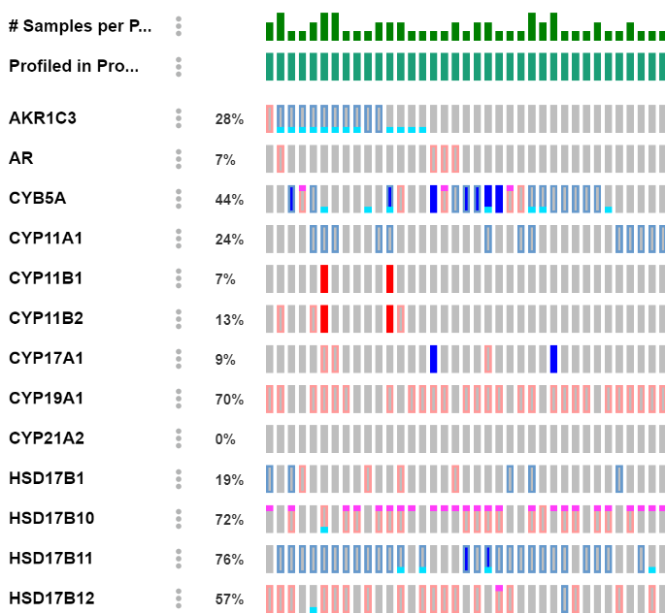
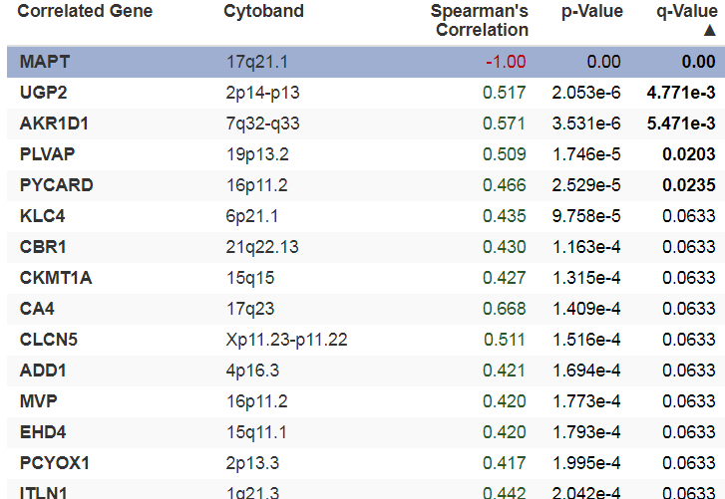
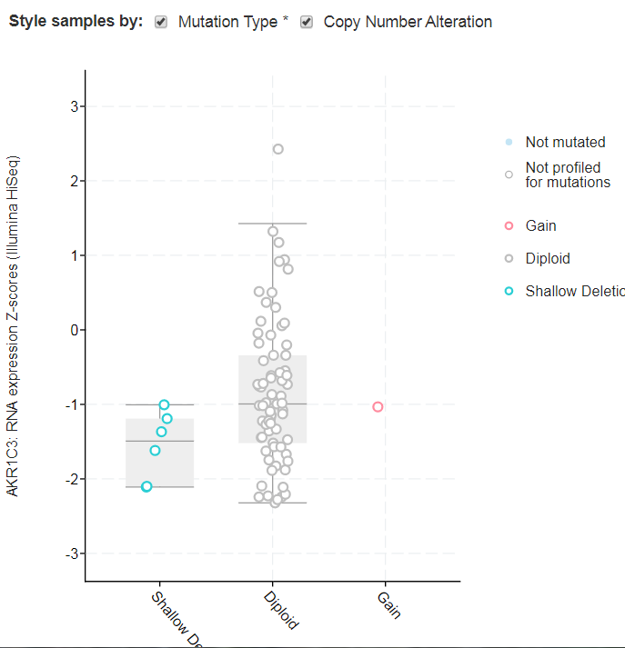
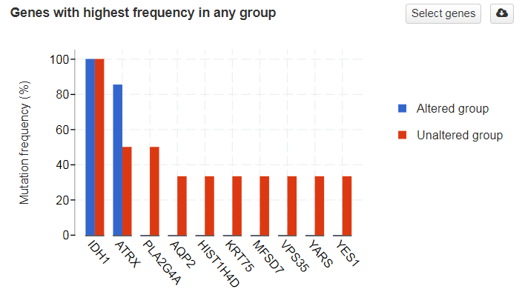
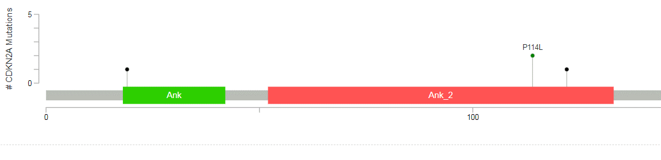
cBioPortal data structure
Studies overview
Study Summary
Patient data
Molecular data

Slide 4
Live demo: playing and testing a public study (TCGA)
cBioPortal Tutorial: exploring Brain Lower Grade Glioma (TCGA, PanCancer Atlas)
Tool: cBioPortal for Cancer Genomics (https://www.cbioportal.org)
Dataset: Brain Lower Grade Glioma (TCGA, PanCancer Atlas)
Goal: Use the dataset to explore mutations, copy number alterations, mRNA expression, survival analysis, clinical data, and more

Slide 5
Step 1: Access the data set
Go to https://www.cbioportal.org
In the "Search Studies" box, type: Brain Lower Grade Glioma (TCGA, PanCancer Atlas)
Click on the corresponding entry.
Hit "Explore Selected Studies"

Slide 6
Step 2: Study view

Slide 7
Step 2: Study view

Slide 8
Step 3: Patient view
Summary page
  Global view of patient related data (Timelines, Genome copy number alterations, Mutations, Structural variants, Copy number alterations)
Pathways
  Pathways enrichment analysis with altered genes

Slide 9
Step 3: Patient view
Clinical data
Files & Links
Pathology report

Slide 10
Step 3: Patient view
Change to Low-Grade Gliomas (UCSF, Science 2014)
Select patients with 7 samples
Focus on genomic evolution

Slide 11
Step 3: Patient view

Slide 12
Step 4: Select Samples and Genes of interest
Example: Add genes of interest like:
  IDH1, IDH2, EGFR
  Click "Submit Query".
Or do it form the summary page

Slide 13
Step 4: Explore the Results
OncoPrint
  Visual summary of genomic alterations (mutations, CNAs, fusions).
  Interactive, color-coded, downloadable.

Slide 14
Step 4: Explore the Results
Cancer Types Summary
  Overview of alterations across subtypes.
Mutual Exclusivity
  Check for co-occurrence/exclusivity of alterations.

Slide 15
Step 4: Explore the Results
Plots (Custom Scatter Plots)
  Correlate expression, clinical data, and mutations.
  Boxplots, violin plots, scatterplots.

Slide 16
Step 4: Explore the Results
Mutations
  Detailed mutation list with annotations and 3D structures.
  Includes lollipop plots.
Structural Variants (Beta) Structural variants detected per patient

Slide 17
Step 4: Explore the Results
Co-expression
  Correlate selected genes with other expressions

Slide 18
Step 4: Explore the Results
Comparison / Survival
  Compare alterations by clinical variables (e.g., stage, ER status).
  Kaplan-Meier plots for overall, disease-free, and progression-free survival.

Slide 19
Step 4: Explore the Results
CN Segments
  Copy number alteration per segment
Pathways
  Pathway analysis for altered genes.

Slide 20
META study
Sample data
META Clinical data
Clinical data
meta_study.txt
data_clinical_sample.txt
meta_clinical_sample.txt
data_clinical_patient.txt
cBioportal data formating card game
Summary
Contains meta data from the cancer study
Key fields
type_of_cancer, cancer_study_identifier, name, description
Summary
Contains sample-level clinical info
Key fields
PATIENT_ID, SAMPLE_ID, etc
Format Tab-delimited
Summary
Contains sample-level metadata
Key fields
cancer_study_identifier, genetic_alteration_type, datatype, data_filename
Summary
Contains patient-level clinical info
Key fields
PATIENT_ID, AGE, SEX, etc.
Format Tab-delimited

Slide 21
Meta study
META study
Type of file data
File name
meta_study.txt
Summary
Contains meta data from the cancer study
Key fields
type_of_cancer, cancer_study_identifier, name, description
Short description of the type of data included on this file and the most important fields that needs to be provided
Number of files user needs to import
Required or optional
Required | 1 of 1

Slide 22
Patient data
Clinical data
META Clinical data
data_clinical_patient.txt
meta_clinical_patient.txt
Summary
Contains patient-level clinical info
Key fields
PATIENT_ID, AGE, SEX, etc.
Format Tab-delimited
Summary
Contains patient-level metadata
Key fields
cancer_study_identifier, genetic_alteration_type, datatype, data_filename
Required | 1 of 2
Required | 2 of 2

Slide 23
Sample data
Sample data
META sample data
data_clinical_sample.txt
meta_clinical_sample.txt
Summary
Contains sample-level clinical info
Key fields
PATIENT_ID, SAMPLE_ID, etc
Format Tab-delimited
Summary
Contains sample-level metadata
Key fields
cancer_study_identifier, genetic_alteration_type, datatype, data_filename
Required | 1 of 2
Required | 2 of 2

Slide 24
Timelines
TREATMENT
(Medical/Radiation Therapy)
STATUS
(patient status)
Timeline data
META timeline data
data_timeline_<token>.txt
meta_timeline_<token>.txt
LAB_TEST
(Type of test performed)
SPECIMEN
(Speciment collection)
Summary
Events ocurring during time
Key fields
PATIENT_ID, START_DATE, STOP_DATE, EVENT_TYPE
Format Tab-delimited
Summary
Contains event types metadata
Key fields
cancer_study_identifier, genetic_alteration_type, datatype, data_filename
IMAGING
(imaging collection)
Optional | 1 of 2 + token
Required | 2 of 2 + token

Slide 25
Discrete copy number data
Discrete copy number data
META Discrete copy number data
CASE discrete copy number
data_cna_discrete.txt
meta_cna_discrete.txt
case_cna.txt
Summary
Contains discrete cna from GISTIC 2.0 or RAE
Key fields
Hugo_Stmbol, Entrez_Gene_Id, SAMPLE_ID_1, etc
Format wide/long Tab-delimited
Summary
Contains cna metadata
Key fields
cancer_study_identifier, genetic_alteration_type, datatype, show_profile_in_analysis_tab,
profile_name, profile_description, data_filename
Summary
List of cases with discrete cna data
Key fields
cancer_study_identifier, stable_id, case_list_name, case_list_description, case_list_ids
Optional | 1 of 3
Required | 2 of 3
Required | 3 of 3

Slide 26
Continuous copy number data
Continuous copy number data
META continuous copy number data
data_log2_cna.txt
meta_log2_cna.txt
Summary
Contains log2 can data
Key fields
Hugo_Stmbol, Entrez_Gene_Id, SAMPLE_ID_1, etc
Format Tab-delimited
Summary
Contains log2 cna metadata
Key fields
cancer_study_identifier, genetic_alteration_type, datatype, show_profile_in_analysis_tab,
profile_name, profile_description, data_filename
Optional | 1 of 2
Required | 2 of 2

Slide 27
Segmented data
Segmented data
META segmented data
data_cna_hg19.txt
meta_cna_hg19.txt
Summary
Contains list of loci and associated numeric values
Key fields
SAMPLE_ID, CHROM, LOC.START, LOC.END, NUM.MARK, SEG.MEAN
Format Tab-delimited
Summary
Contains segmented metadata
Key fields
cancer_study_identifier, genetic_alteration_type, datatype, reference_genome_id, description, data_filename
Optional | 1 of 2
Required | 2 of 2

Slide 28
Expression data
Expression data
META expression data
data_expression.txt
meta_expression.txt
Summary
Contains gene expression values in continuous, discrete or z-score format
Key fields
HUGO_SYMBOL, ENTREZ_GENE_ID, SAMPLE_ID_1, etc
Format Tab-delimited
Summary
Contains expression metadata
Key fields
cancer_study_identifier, genetic_alteration_type, datatype, stable_id, show_profile_in_analysis_tab, profile_name, profile_description, data_filename
Optional | 1 of 2
Required | 2 of 2

Slide 29
Mutation data
Mutation data
META mutation data
CASE sequenced data
data_mutations.txt
meta_mutations.txt
case_sequenced.txt
Summary
Contains genetic variants in MAF format.
Key fields
32 columns from the TCGA MAF format.
Format Tab-delimited
Summary
Contains genetic variants metadata
Key fields
cancer_study_identifier, genetic_alteration_type, datatype, stable_id, show_profile_in_analysis_tab, profile_description, profile_name, data_filename, namespaces
Summary
List of cases with mutation data
Key fields
cancer_study_identifier, stable_id, case_list_name, case_list_description, case_list_ids
Optional | 1 of 3
Required | 2 of 3
Required | 3 of 3

Slide 30
Methylation data
Methylation data
META methylation data
data_methylation.txt
meta_methylation.txt
Summary
Contains a bet-value from the Infinium methylation array platform
Key fields
HUGO_SYMBOL, ENTREZ_GENE_ID, SAMPLE_ID_1, etc
Format Tab-delimited
Summary
Contains methylation metadata
Key fields
cancer_study_identifier, genetic_alteration_type, datatype, stable_id, show_profile_in_analysis_tab, profile_name, profile_description, data_filename
Optional | 1 of 2
Required | 2 of 2

Slide 31
Protein level data
Protein level data
META protein level data
data_protein.txt
meta_protein.txt
Summary
Protein expression measured by reverse-phase protein array or mass spectrometry (log2 or z-score)
Key fields
COMPOSITE.ELEMENT.REF, SAMPLE_ID_1, etc
Format Tab-delimited
Summary
Contains protein level metadata
Key fields
cancer_study_identifier, genetic_alteration_type, datatype, stable_id, show_profile_in_analysis_tab, profile_name, profile_description, data_filename
Optional | 1 of 2
Required | 2 of 2

Slide 32
Structural Variant data
Strucutral variant data
META structural variant data
CASE SV data
data_sv.txt
meta_sv.txt
case_sv.txt
Summary
Contains all kinds of structural vairants
Key fields
SAMPLE_ID, SV_STATUS, etc (check table online)
Format Tab-delimited
Summary
Contains structural variant metadata
Key fields
cancer_study_identifier, genetic_alteration_type, datatype, stable_id, show_profile_in_analysis_tab, profile_name, profile_description, data_filename
Summary
List of cases with sv data
Key fields
cancer_study_identifier, stable_id, case_list_name, case_list_description, case_list_category, case_list_ids
Optional | 1 of 3
Required | 2 of 3
Required | 3 of 3

Slide 33
CASE lists
mRNA (microarray)
(_mrna)
mRNA (RNA-seq)
(_rna_seq_mrna)
Sequenced
(_sequenced)
Required²
CNA
(_cna)
Required³
CASE lists
case_<suffix>.txt
All
(_all)
Required¹
SV
(_sv)
Sequenced and CNA
(_cnaseq)
Methylation (HM27)
(_methylation_hm27)
Summary
Used to define sample lists that can be selected in the query page
Key fields
cancer_study_identifier, stable_id, case_list_name, case_list_description, case_list_category, case_list_ids
1. This can be generated by the importer if you set the attribute add_global_case_list to true in the Study metadata
2. This case list is required when loading mutation data
3. This case list is rquired when loading discrete cna data
Required | 1 of “n”*suffix

Slide 34

Build your deck
Use case: Blood Sample Monitoring in Study Alpha
Back ground:
Study Alpha involves the active collection of blood samples from cancer patients who meet specific inclusion criteria.
Objective:
A researcher needs an intuitive and eficient tool to:
  Track and visualize the status of blood sample collection for all patients enrolled in the study.
  Follow up of the patient treatments.
  Filter and compare patients based on clinical characteristics (e.g., cancer type, stage, age, treatment received) to facilitate analysis and interpretation.

Slide 35
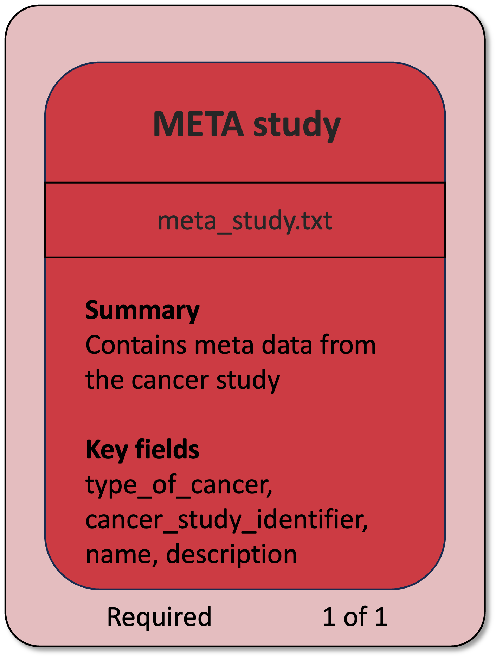
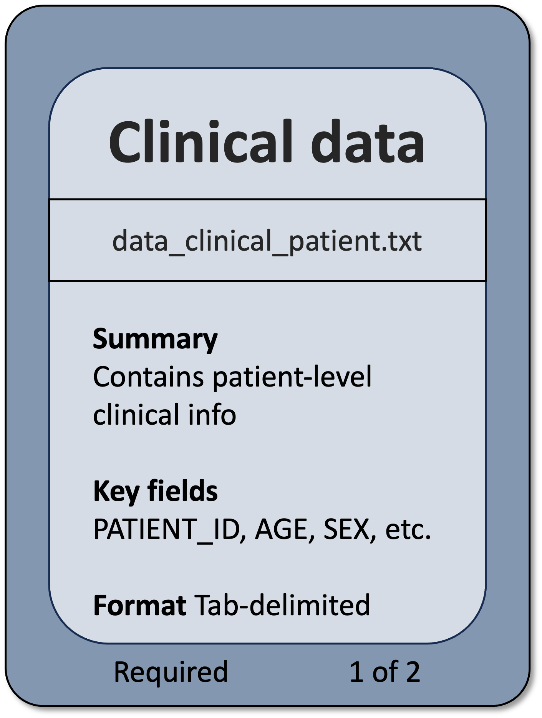
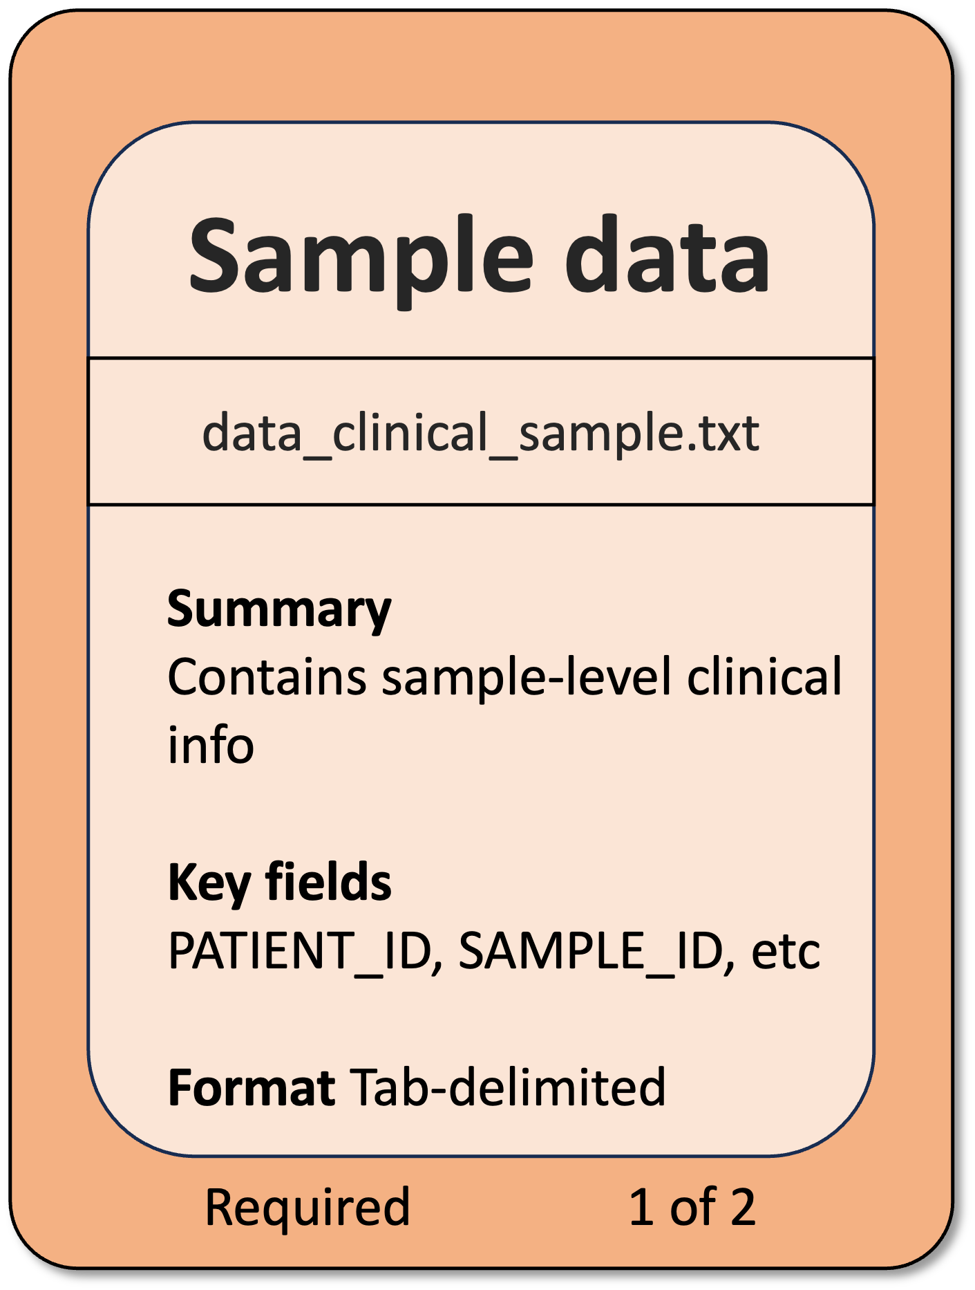
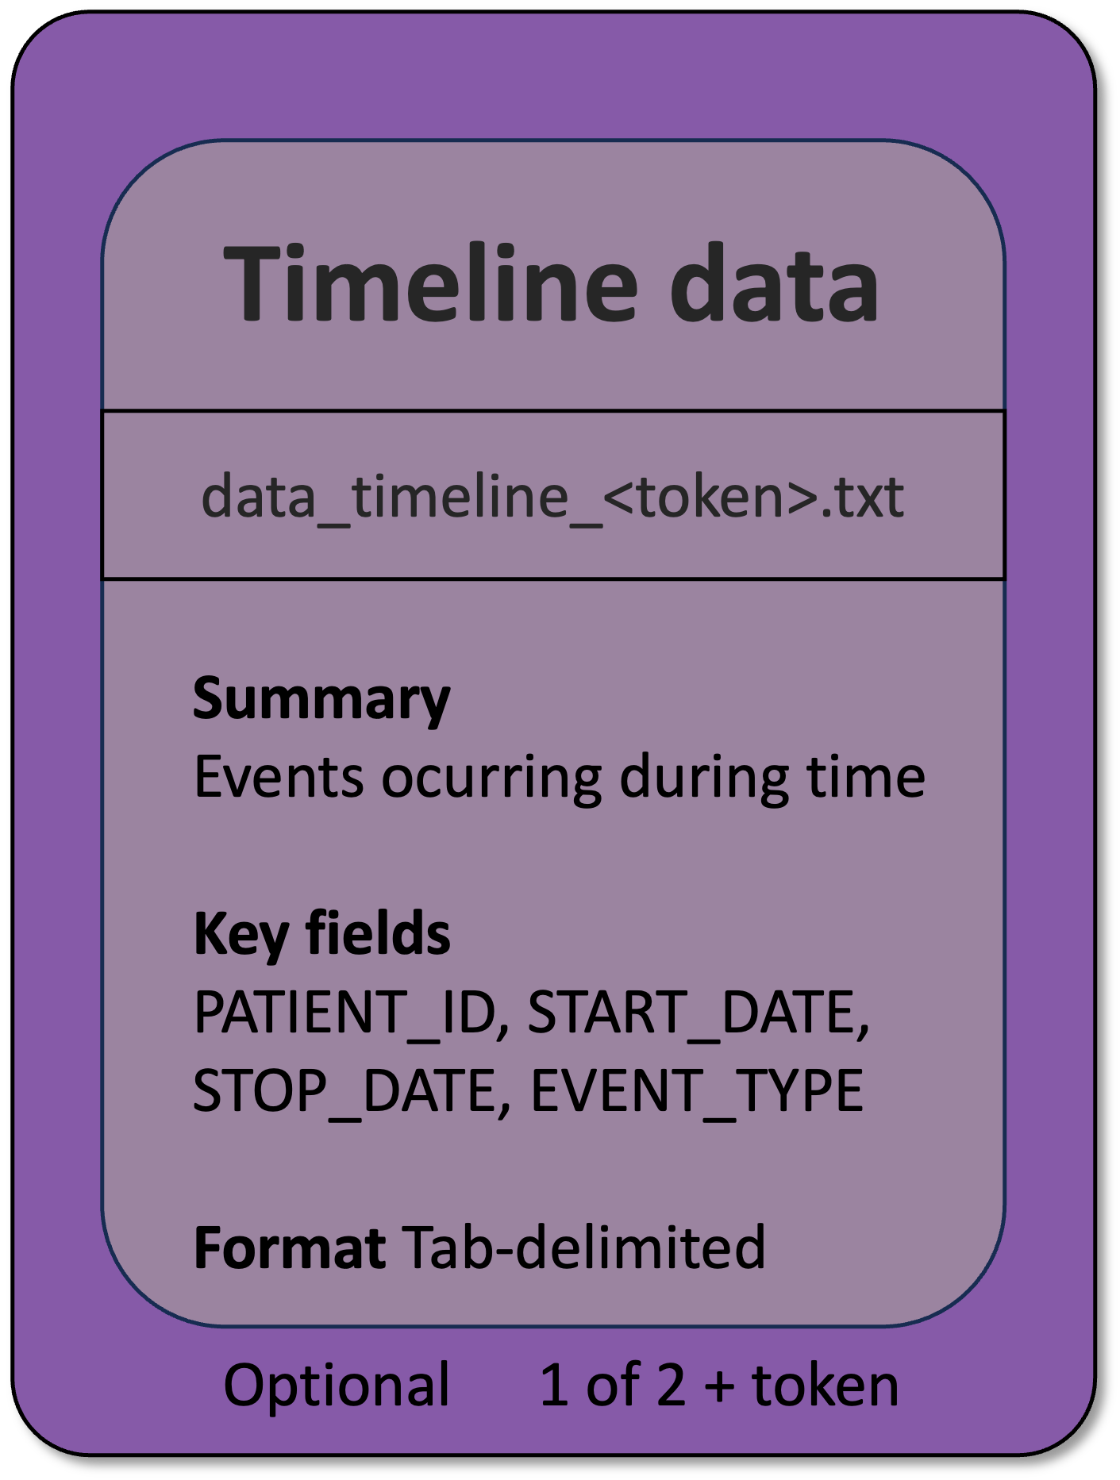
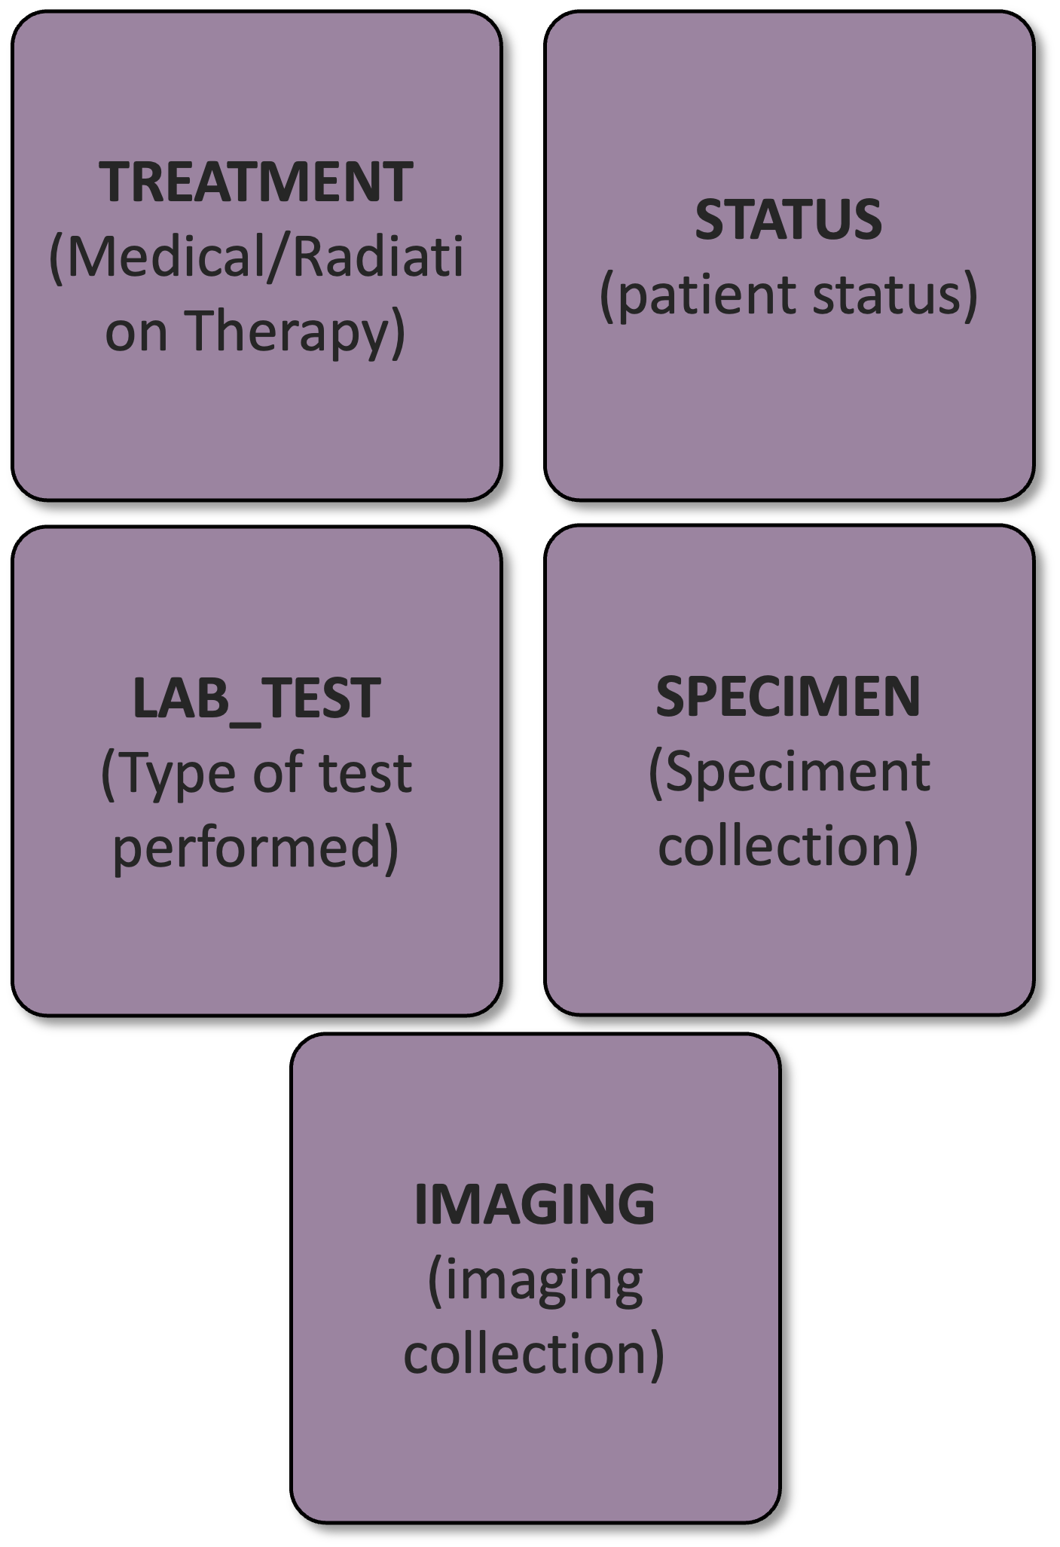
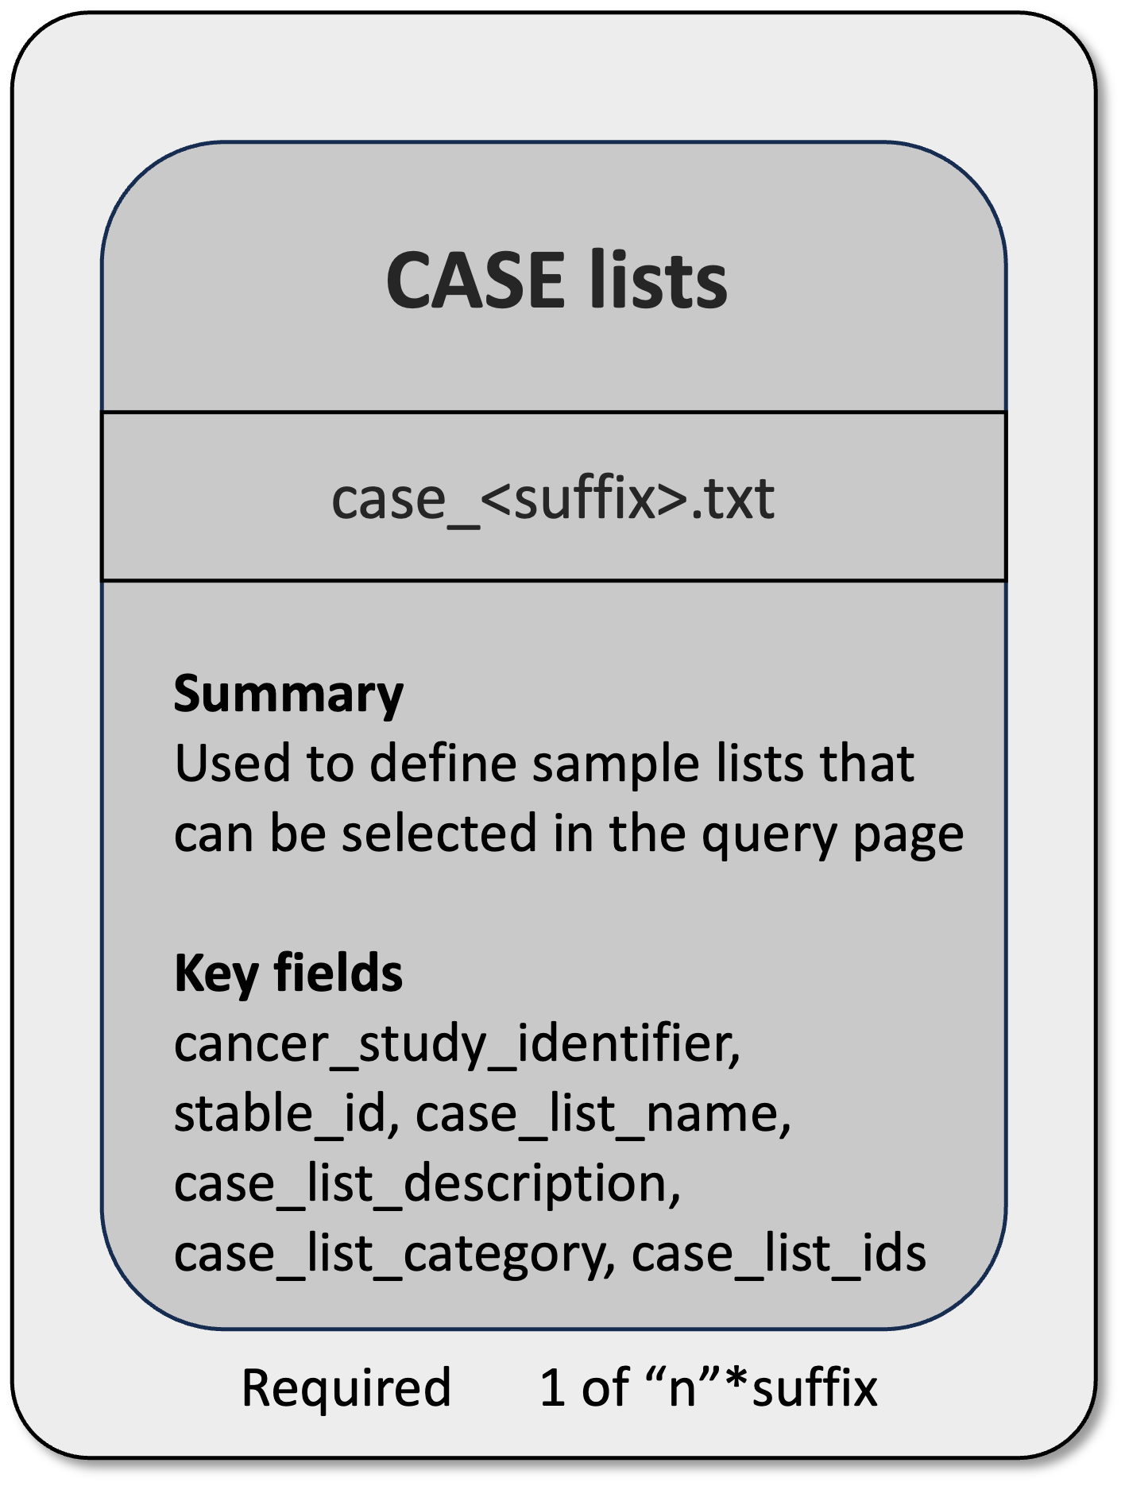
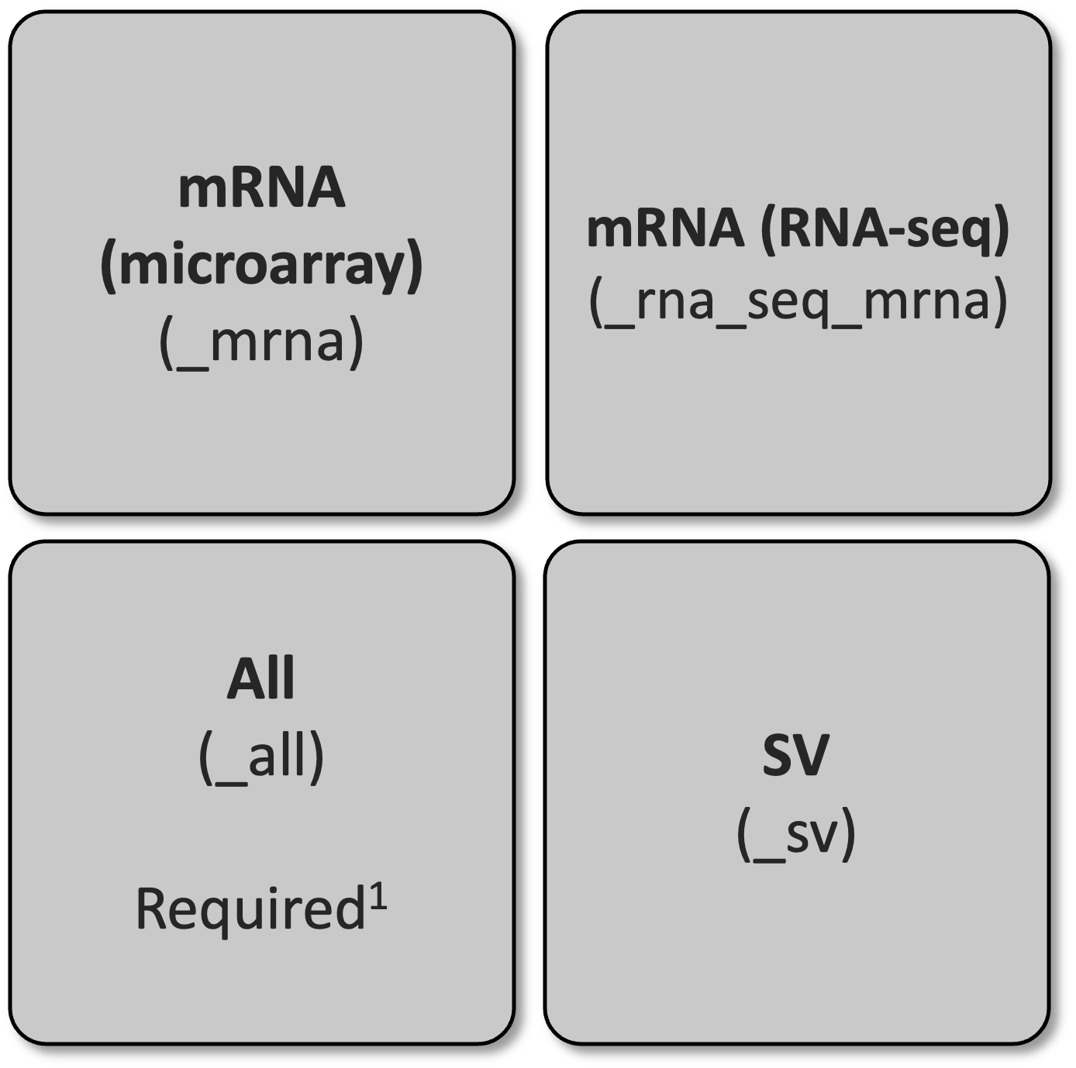
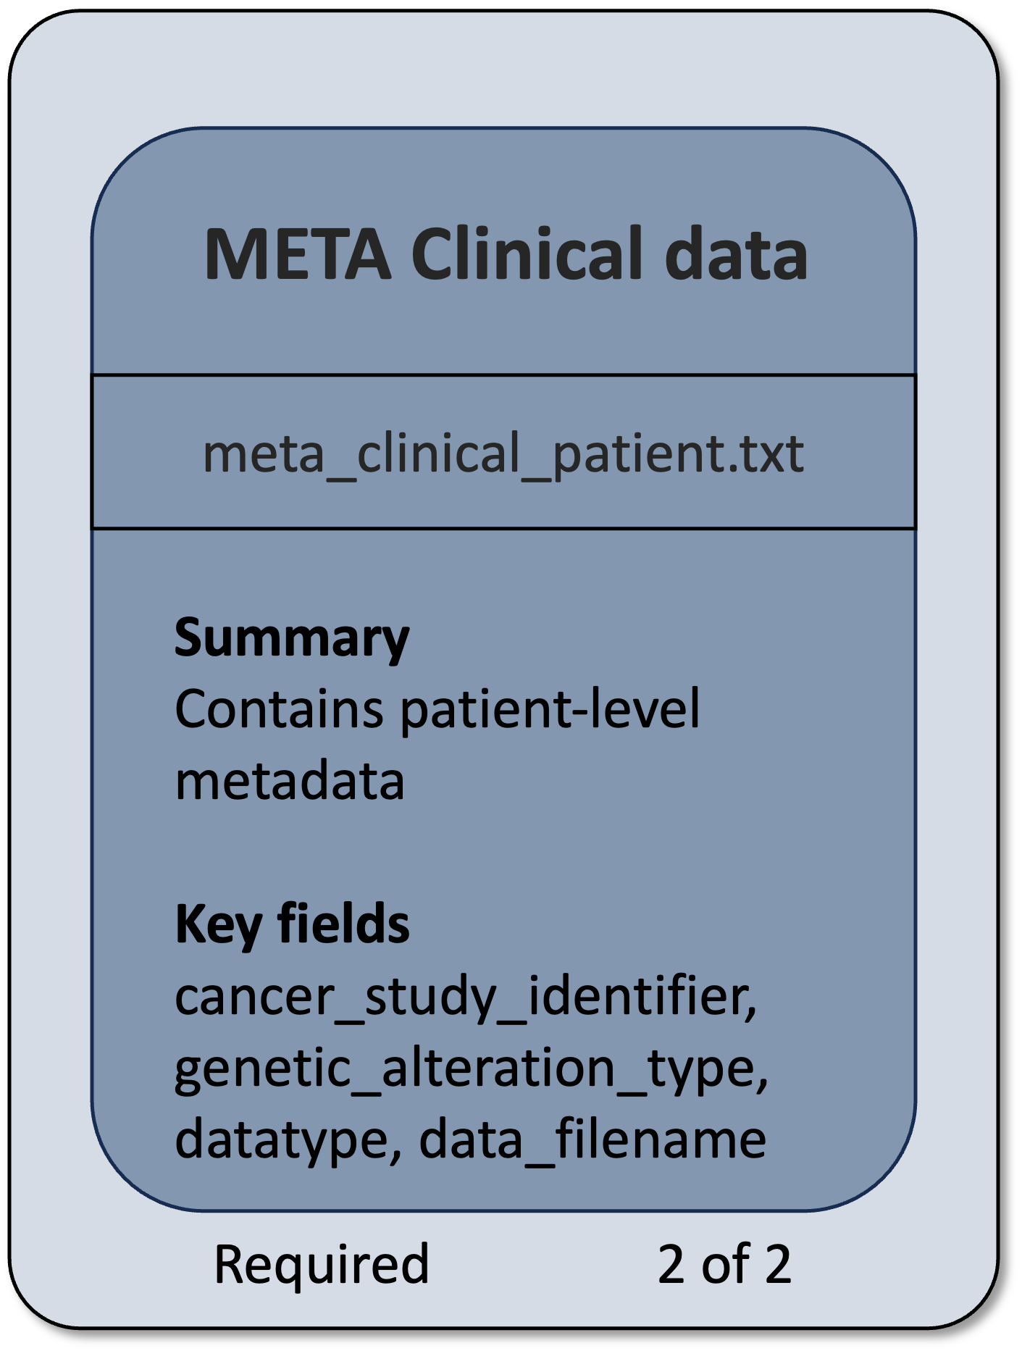
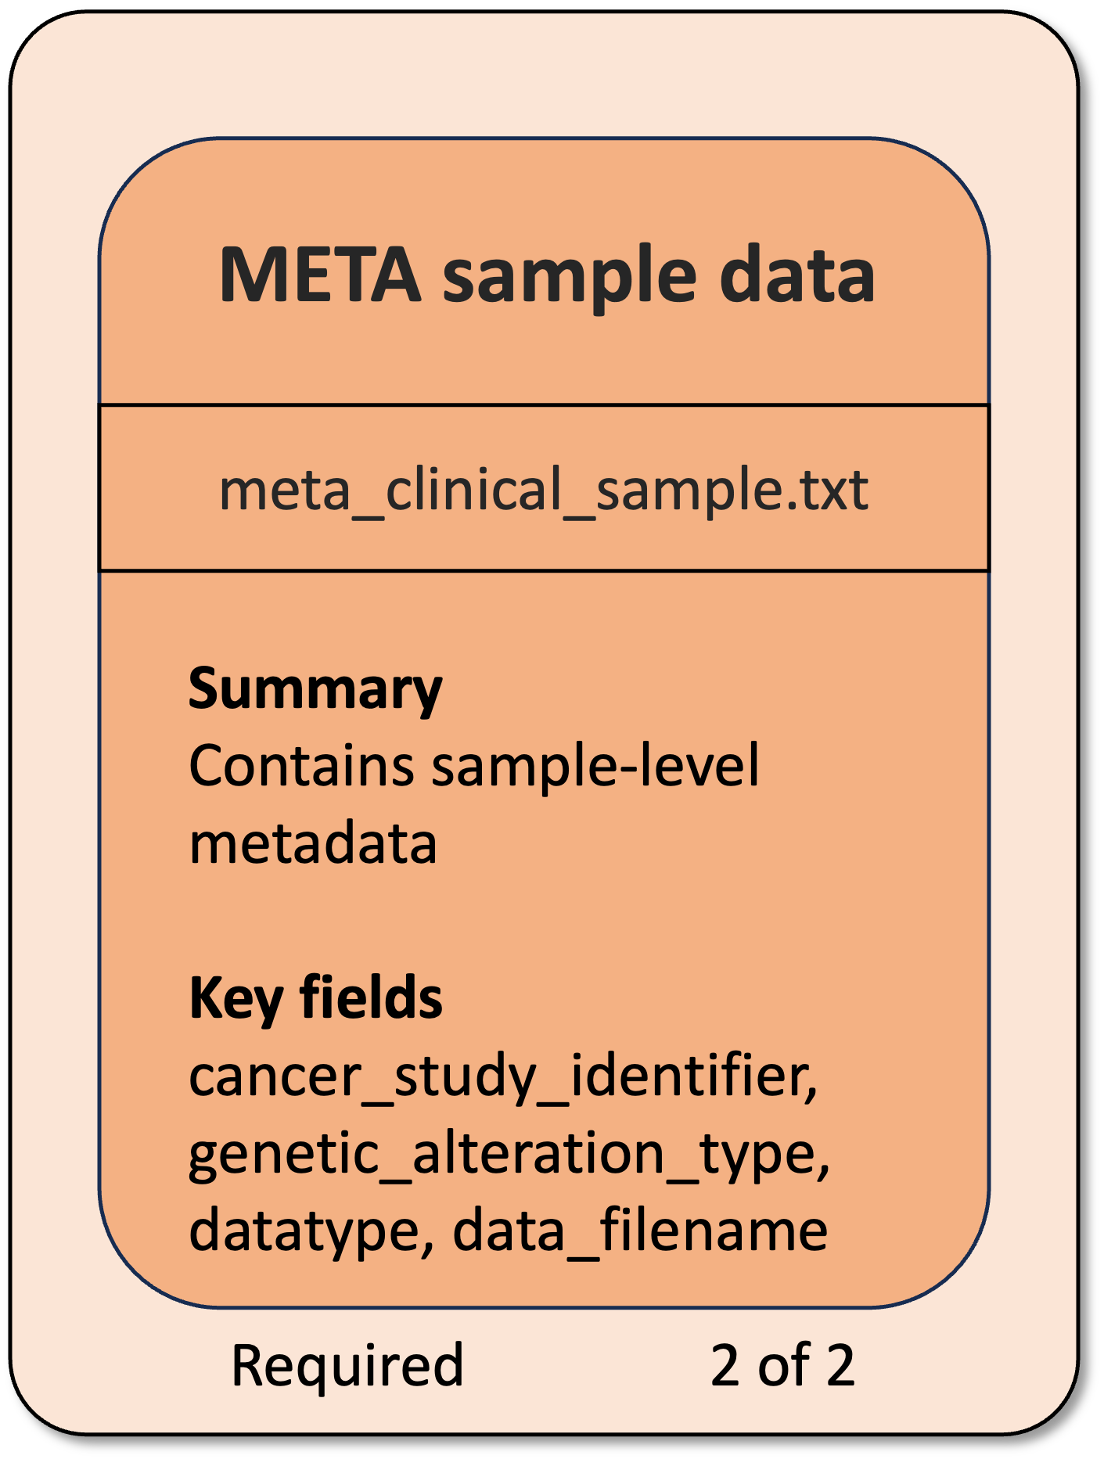
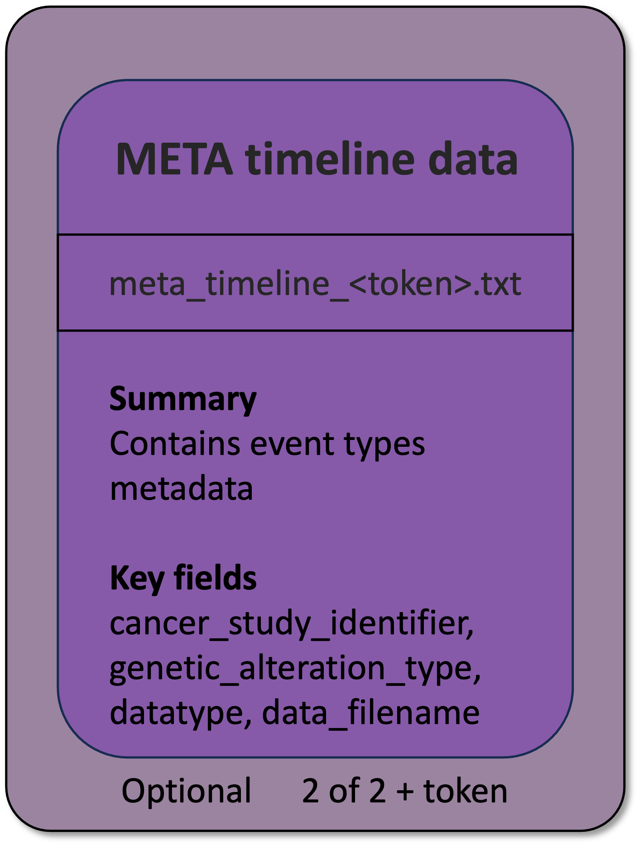
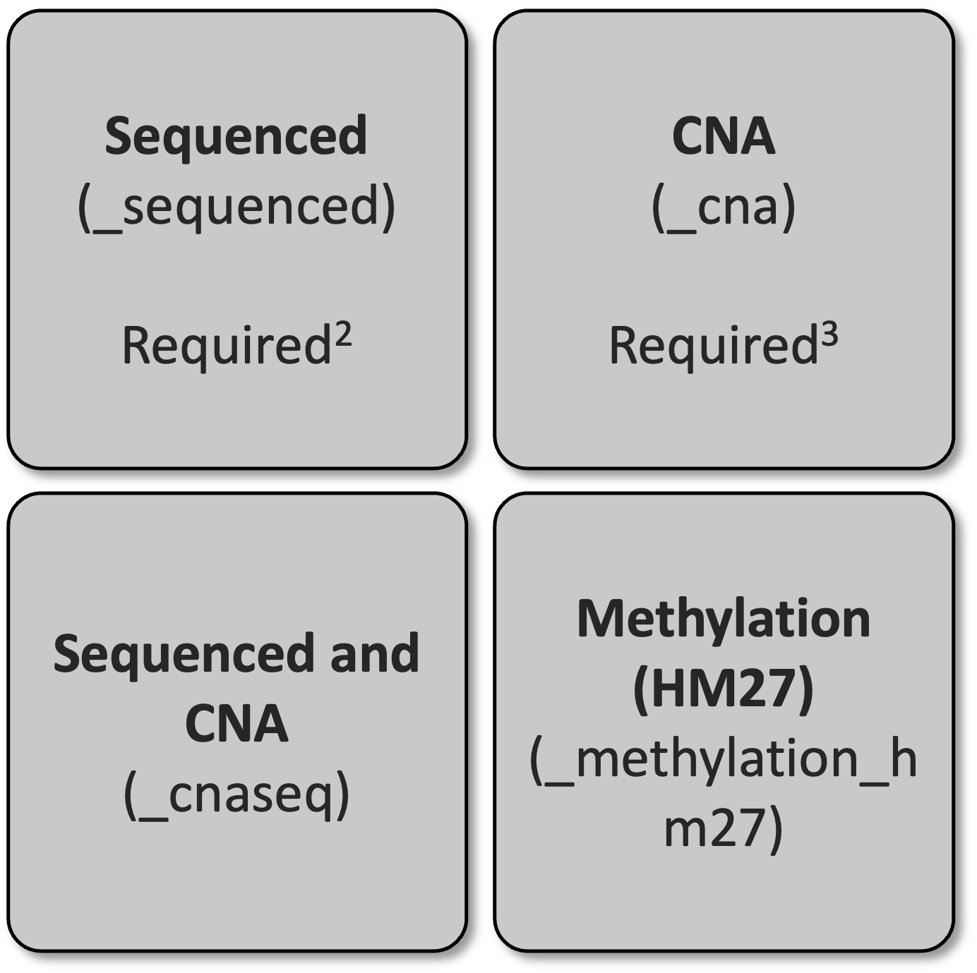
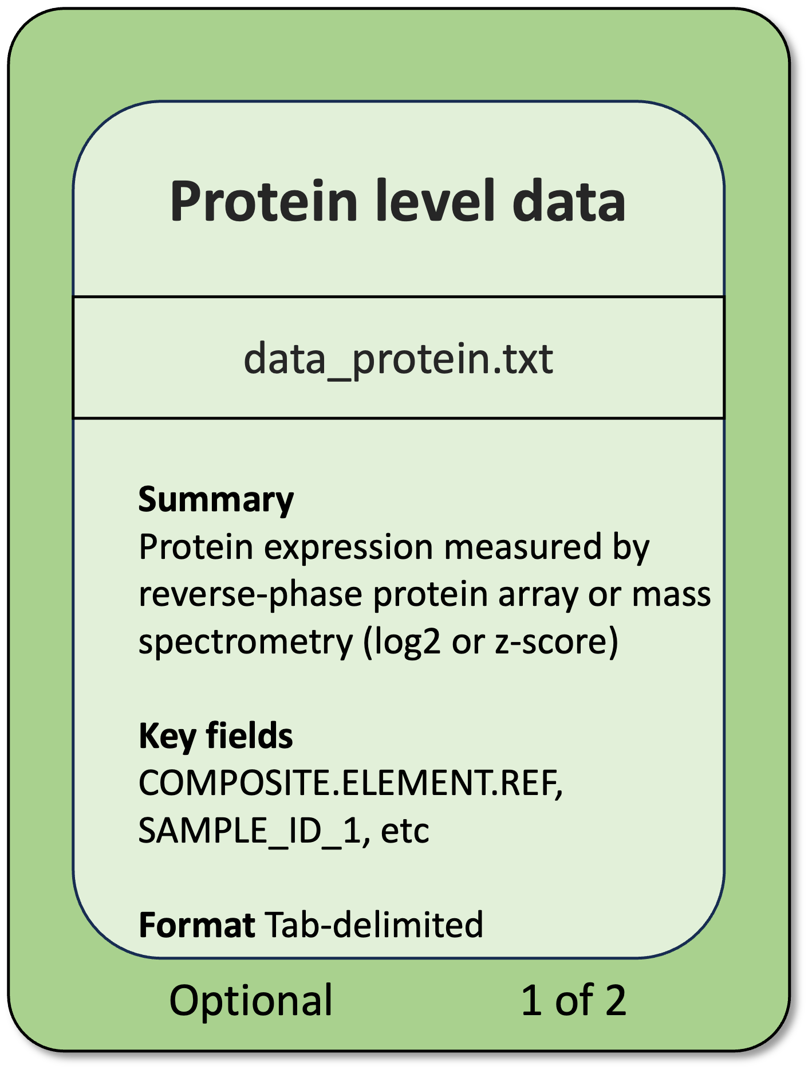
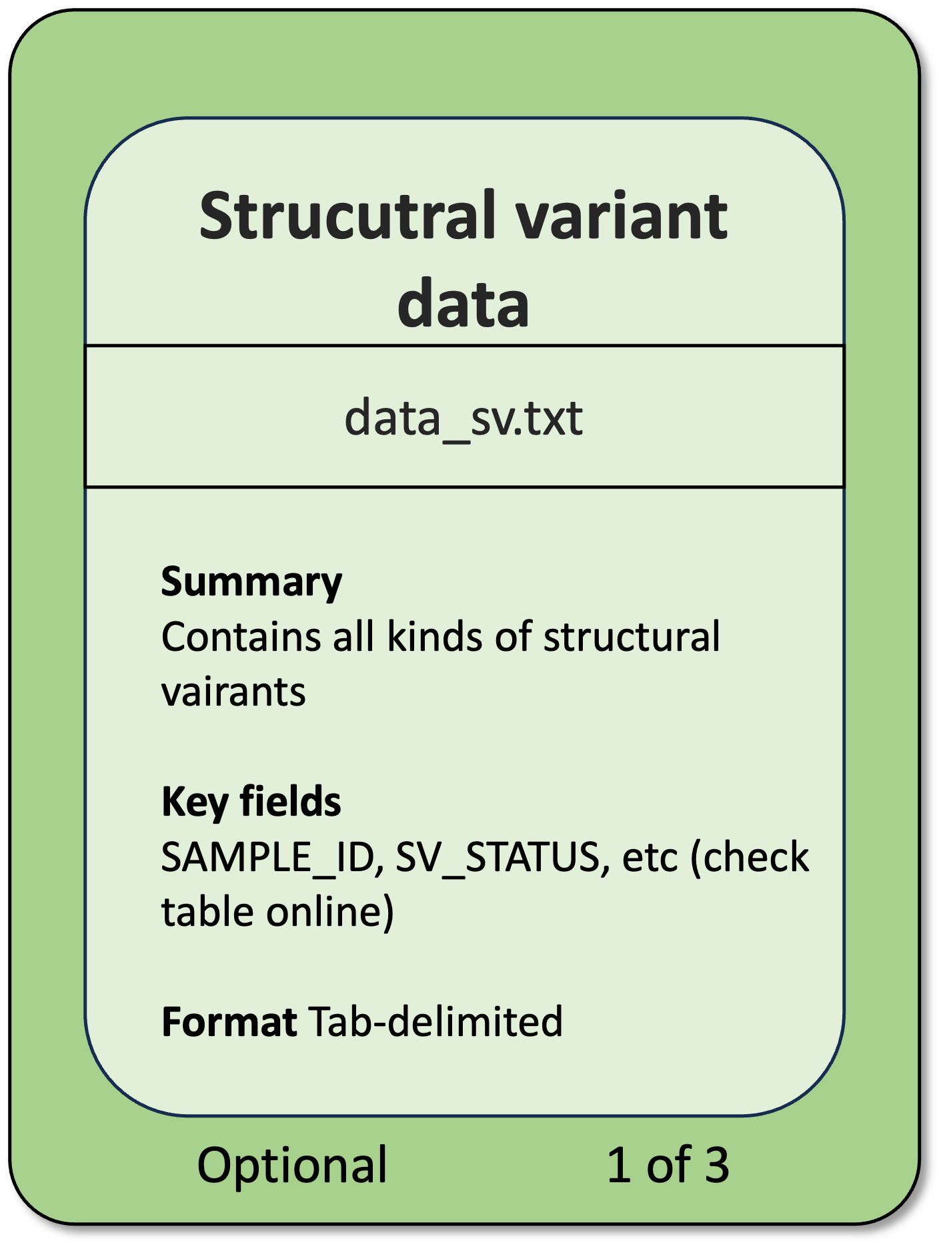
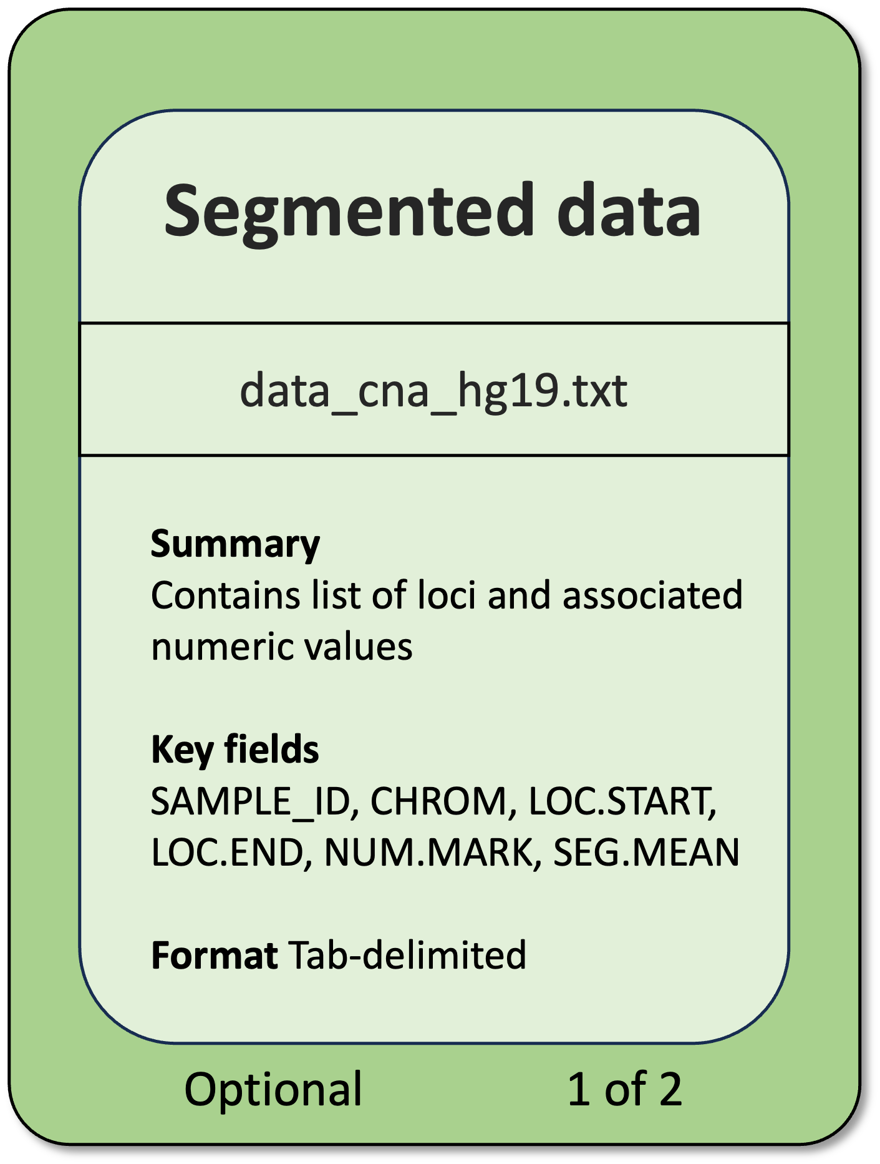
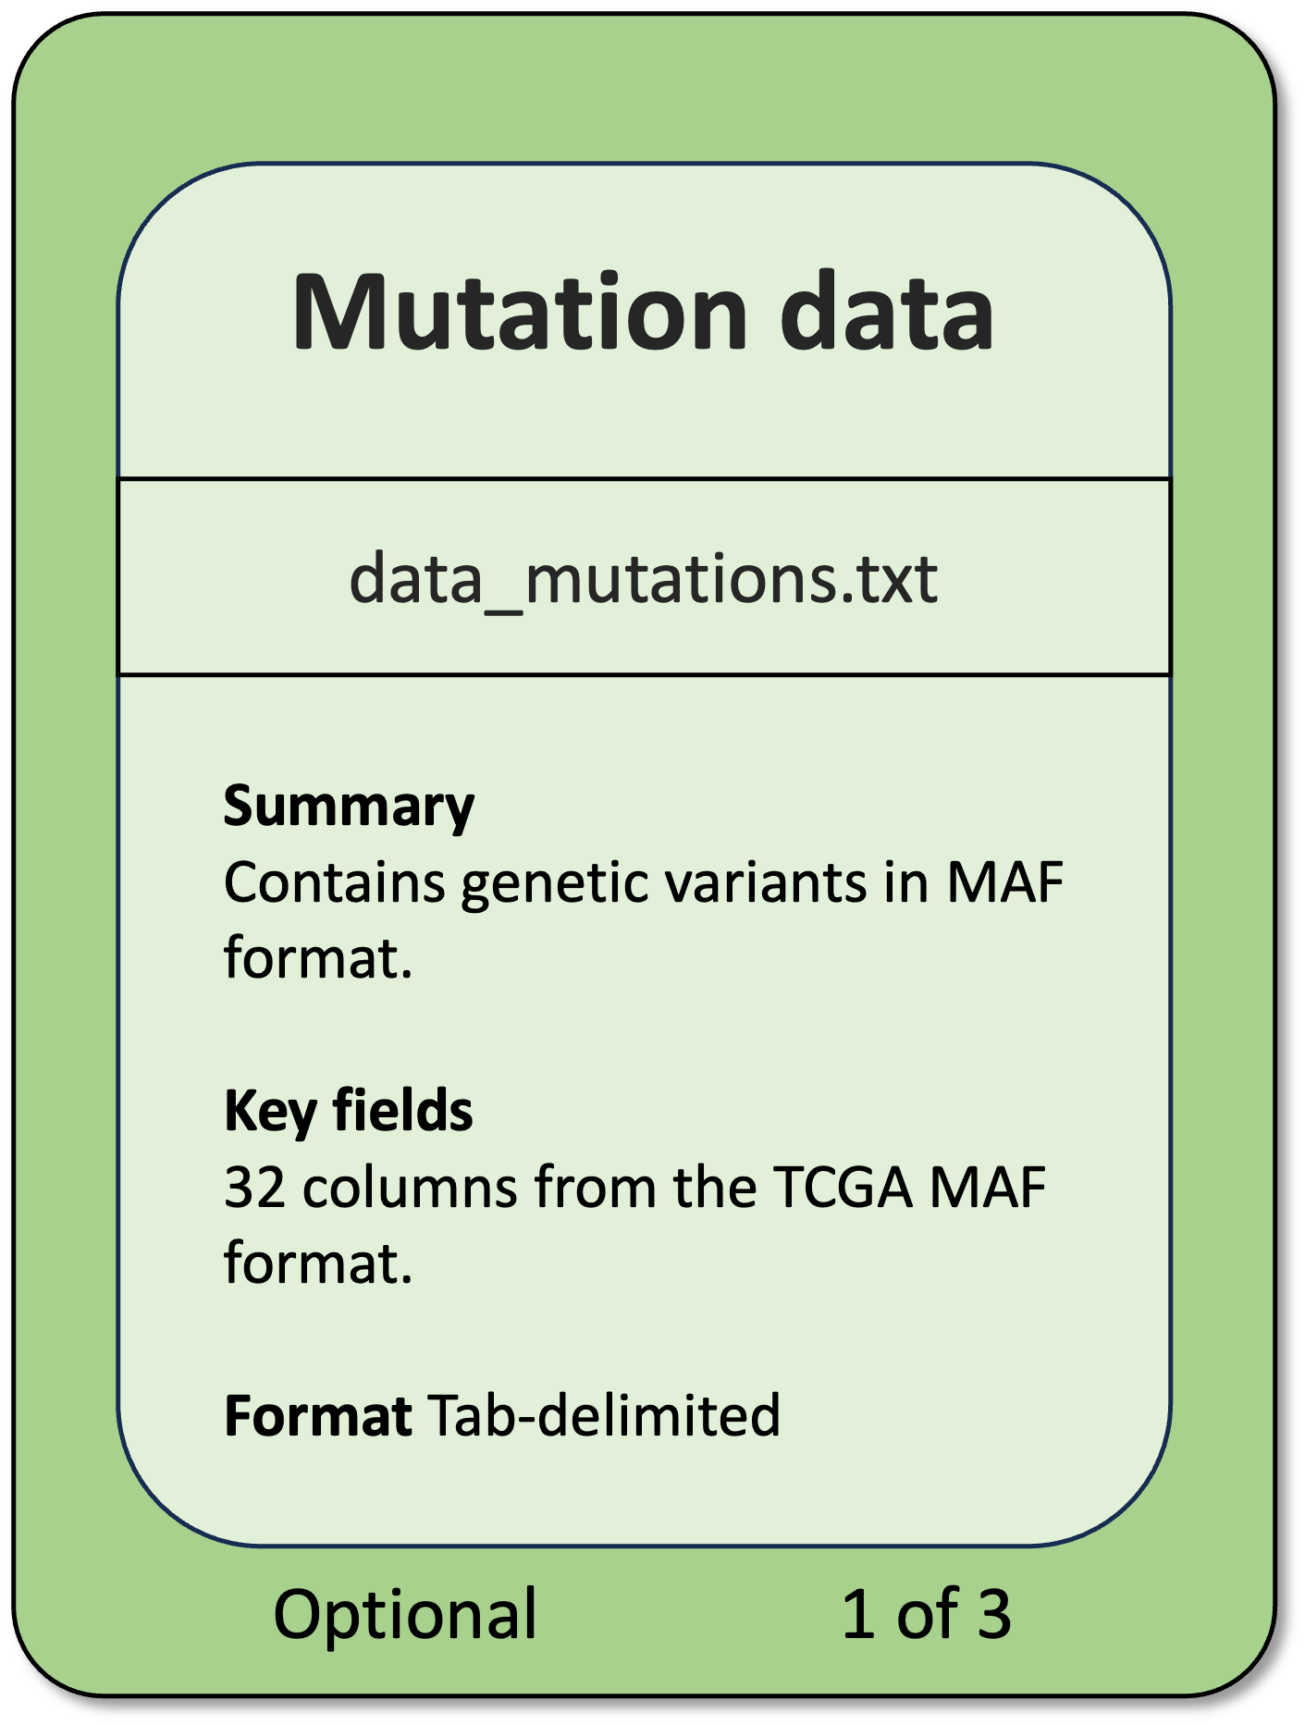
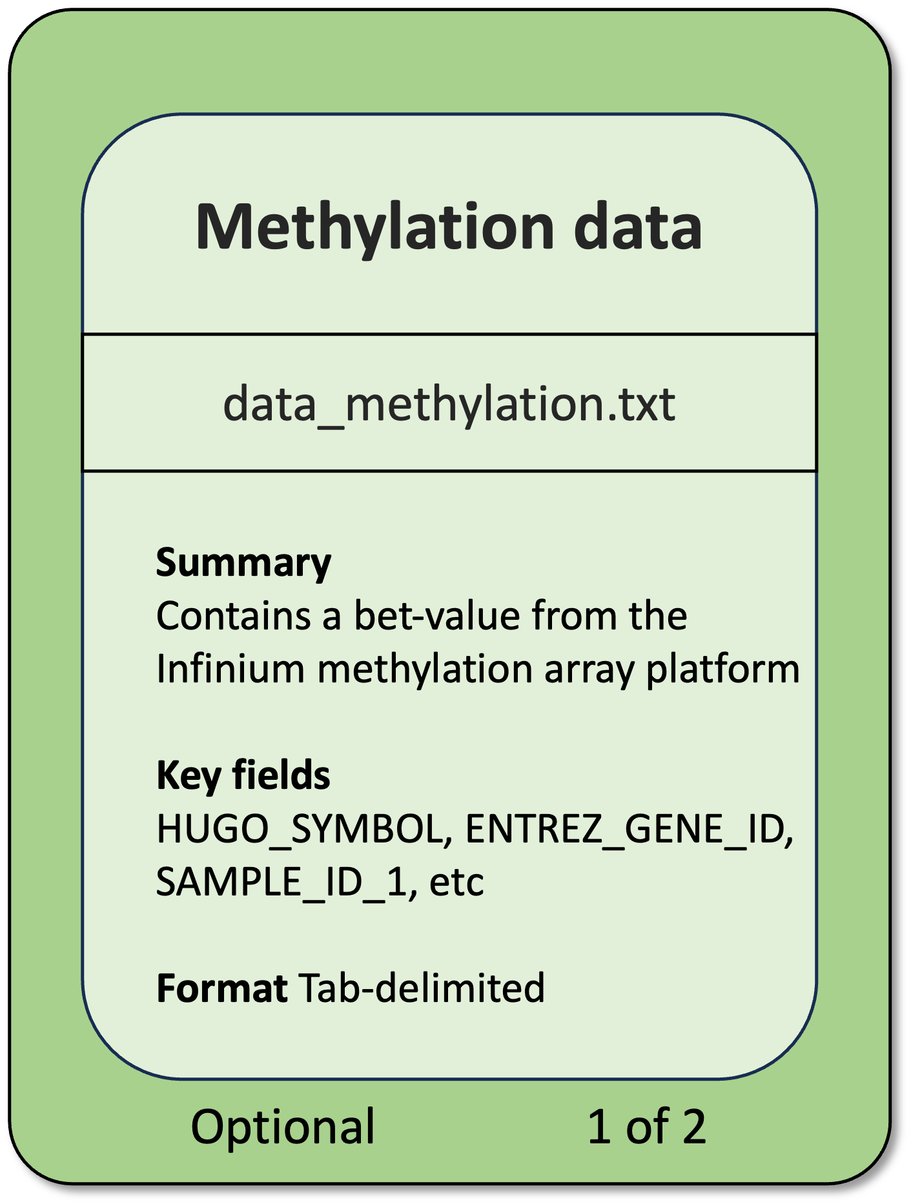
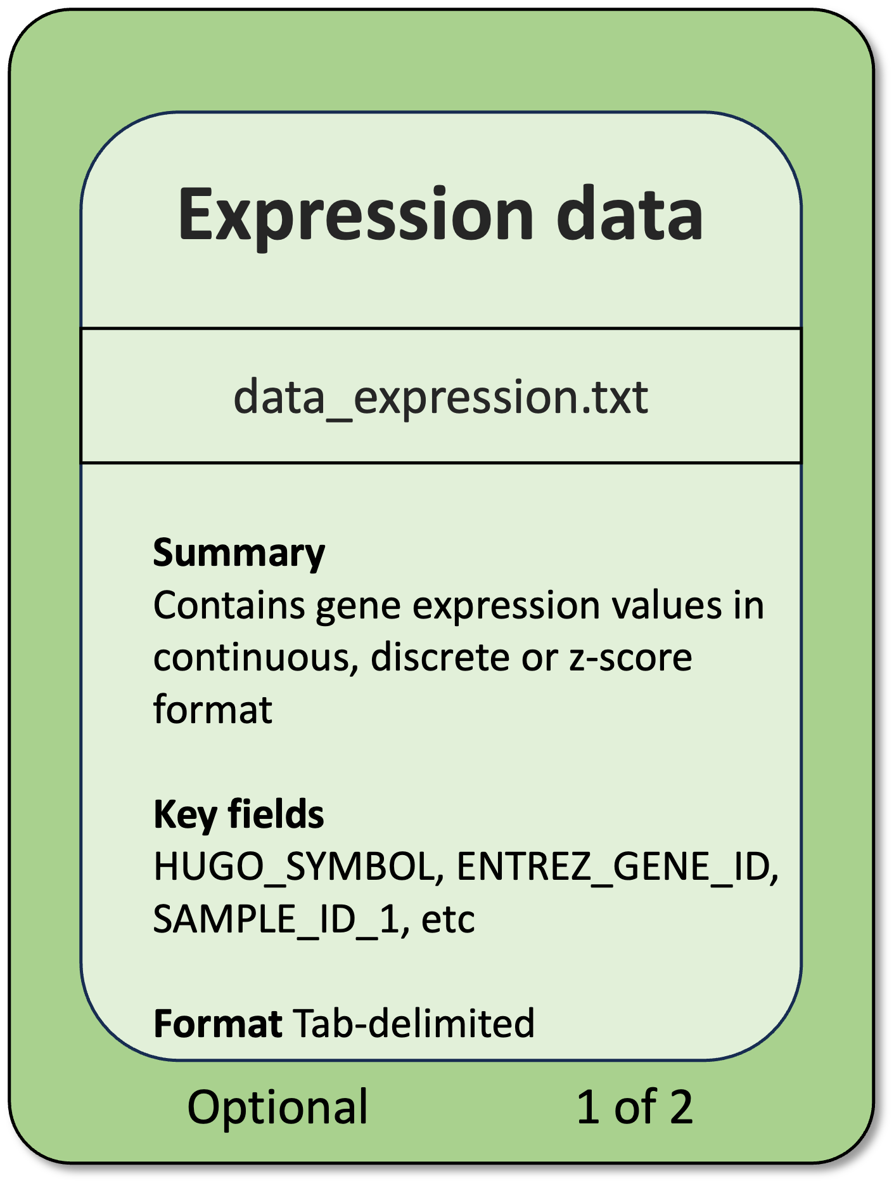
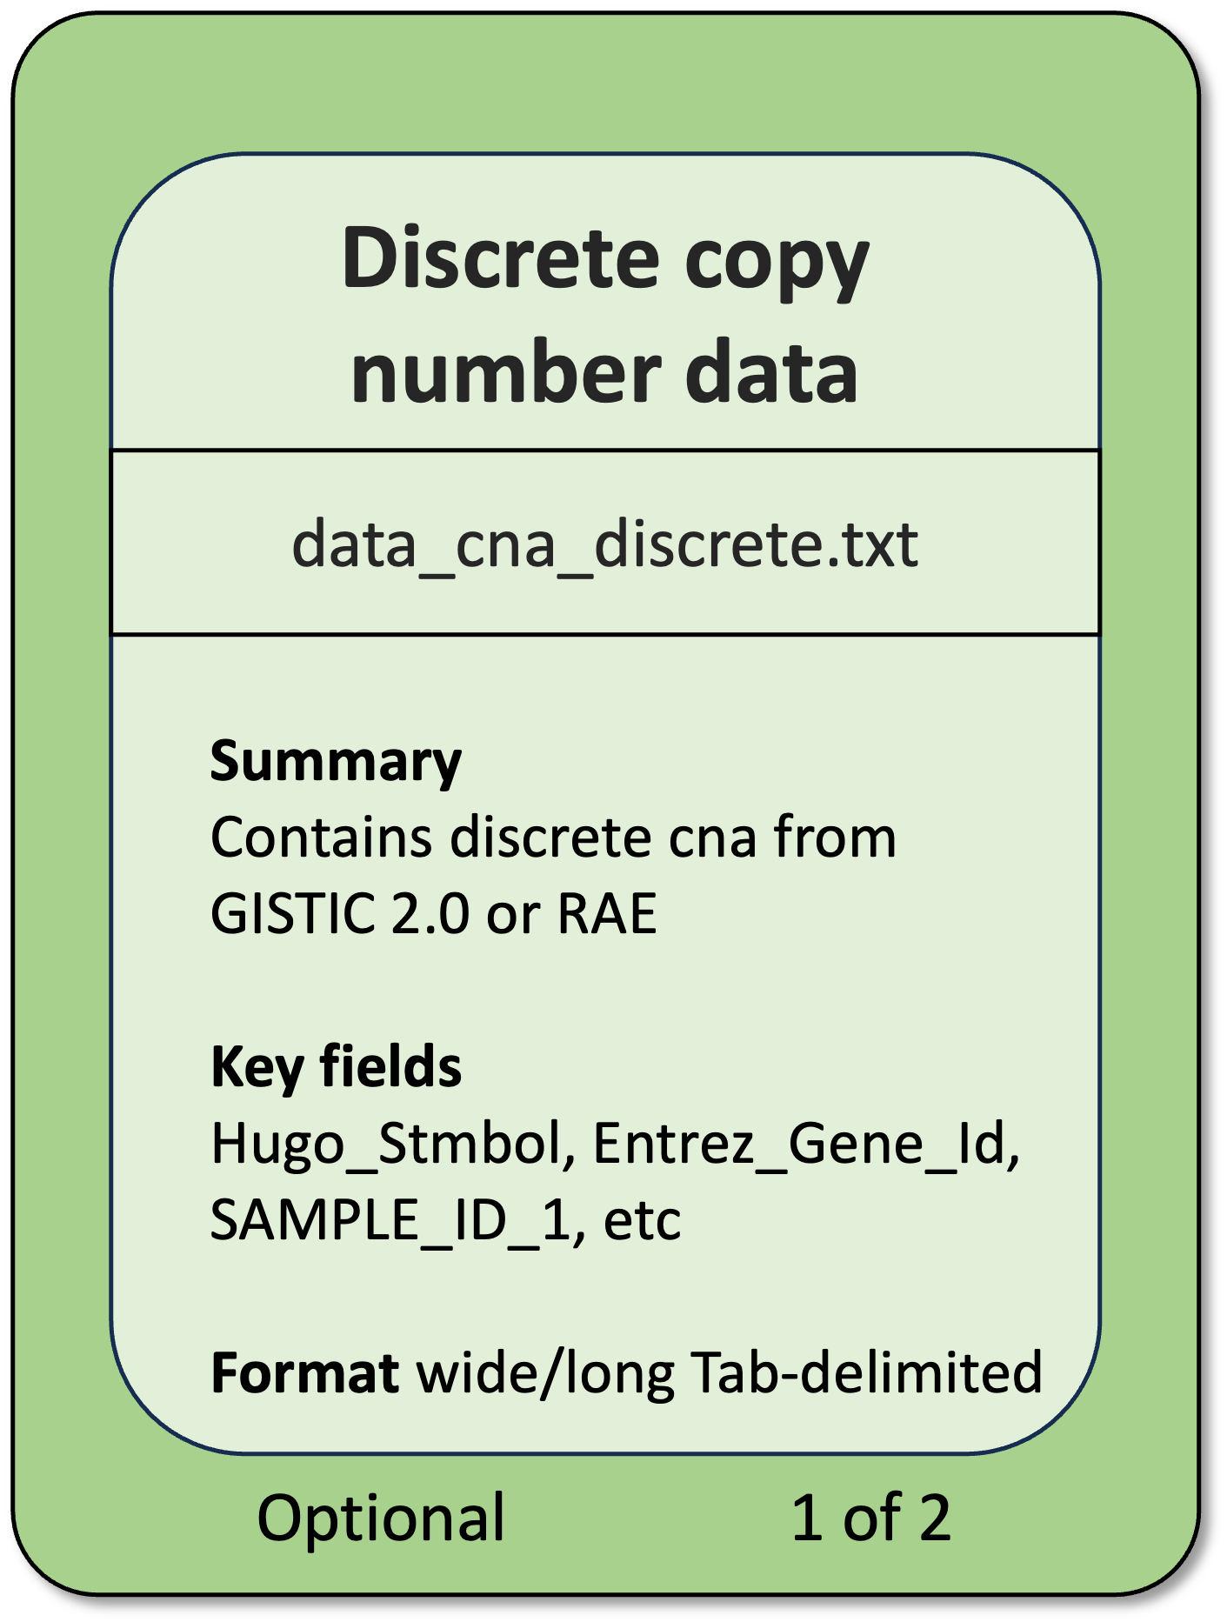
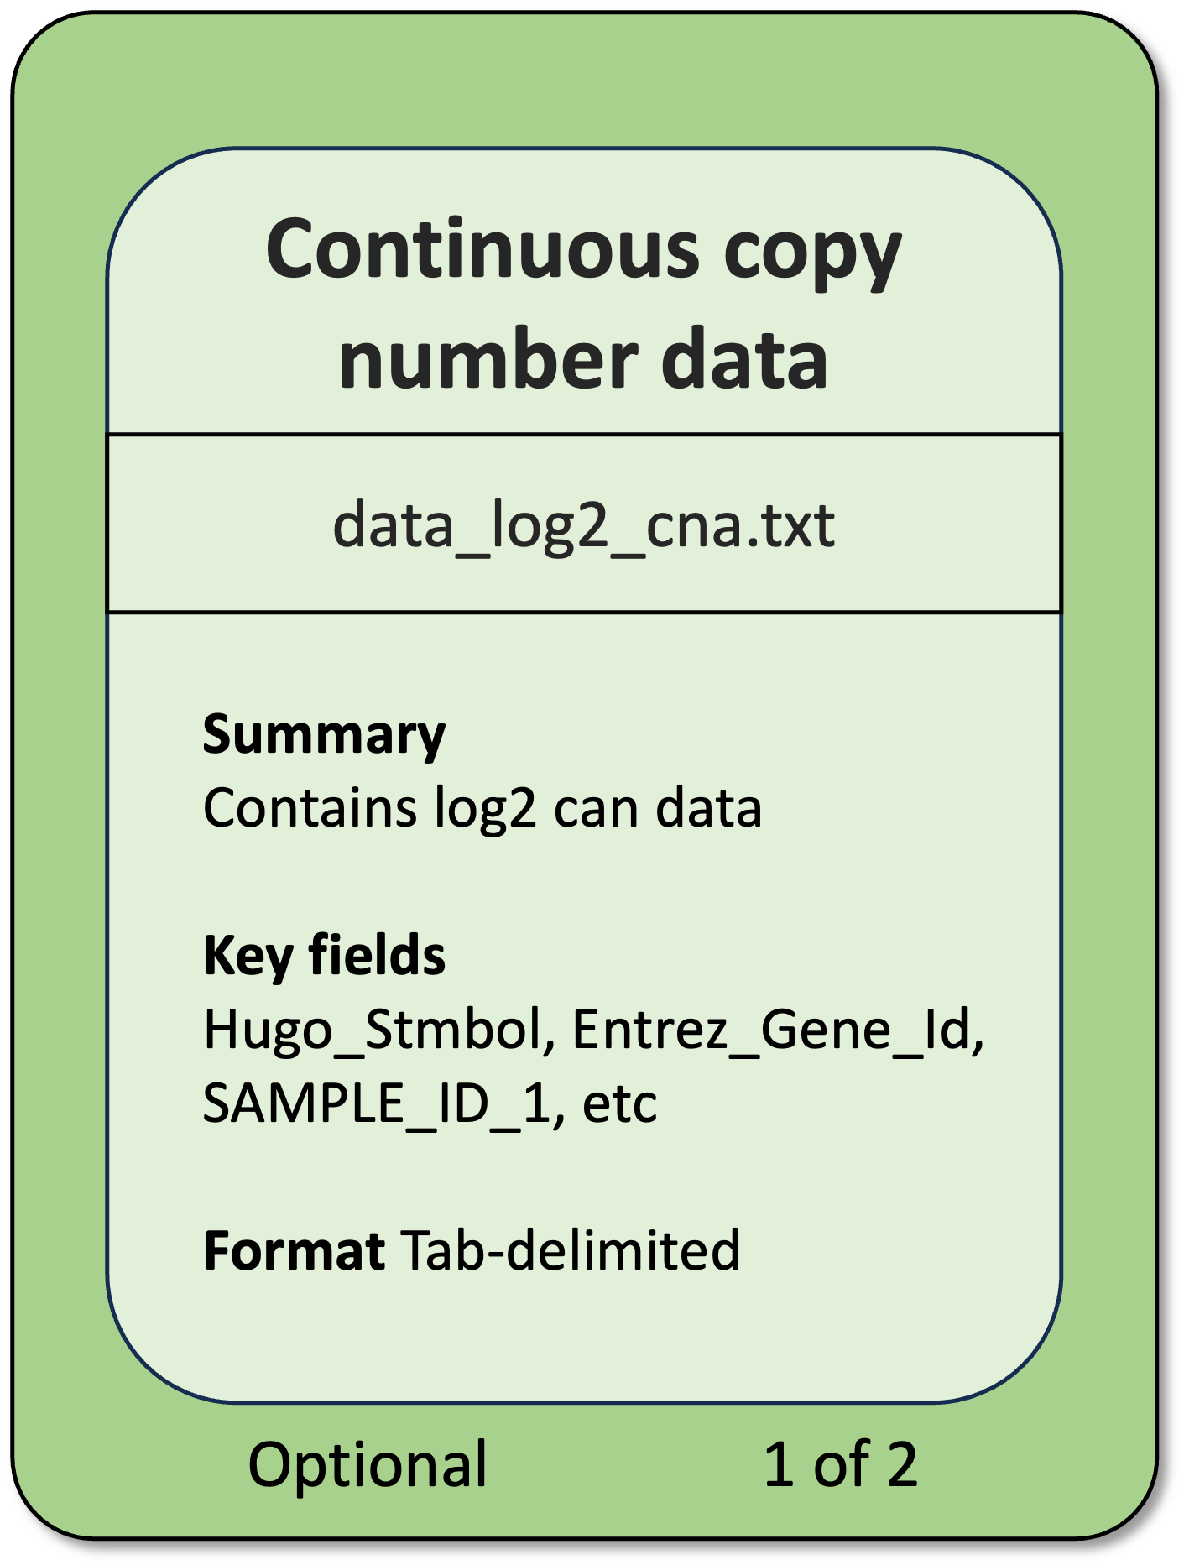
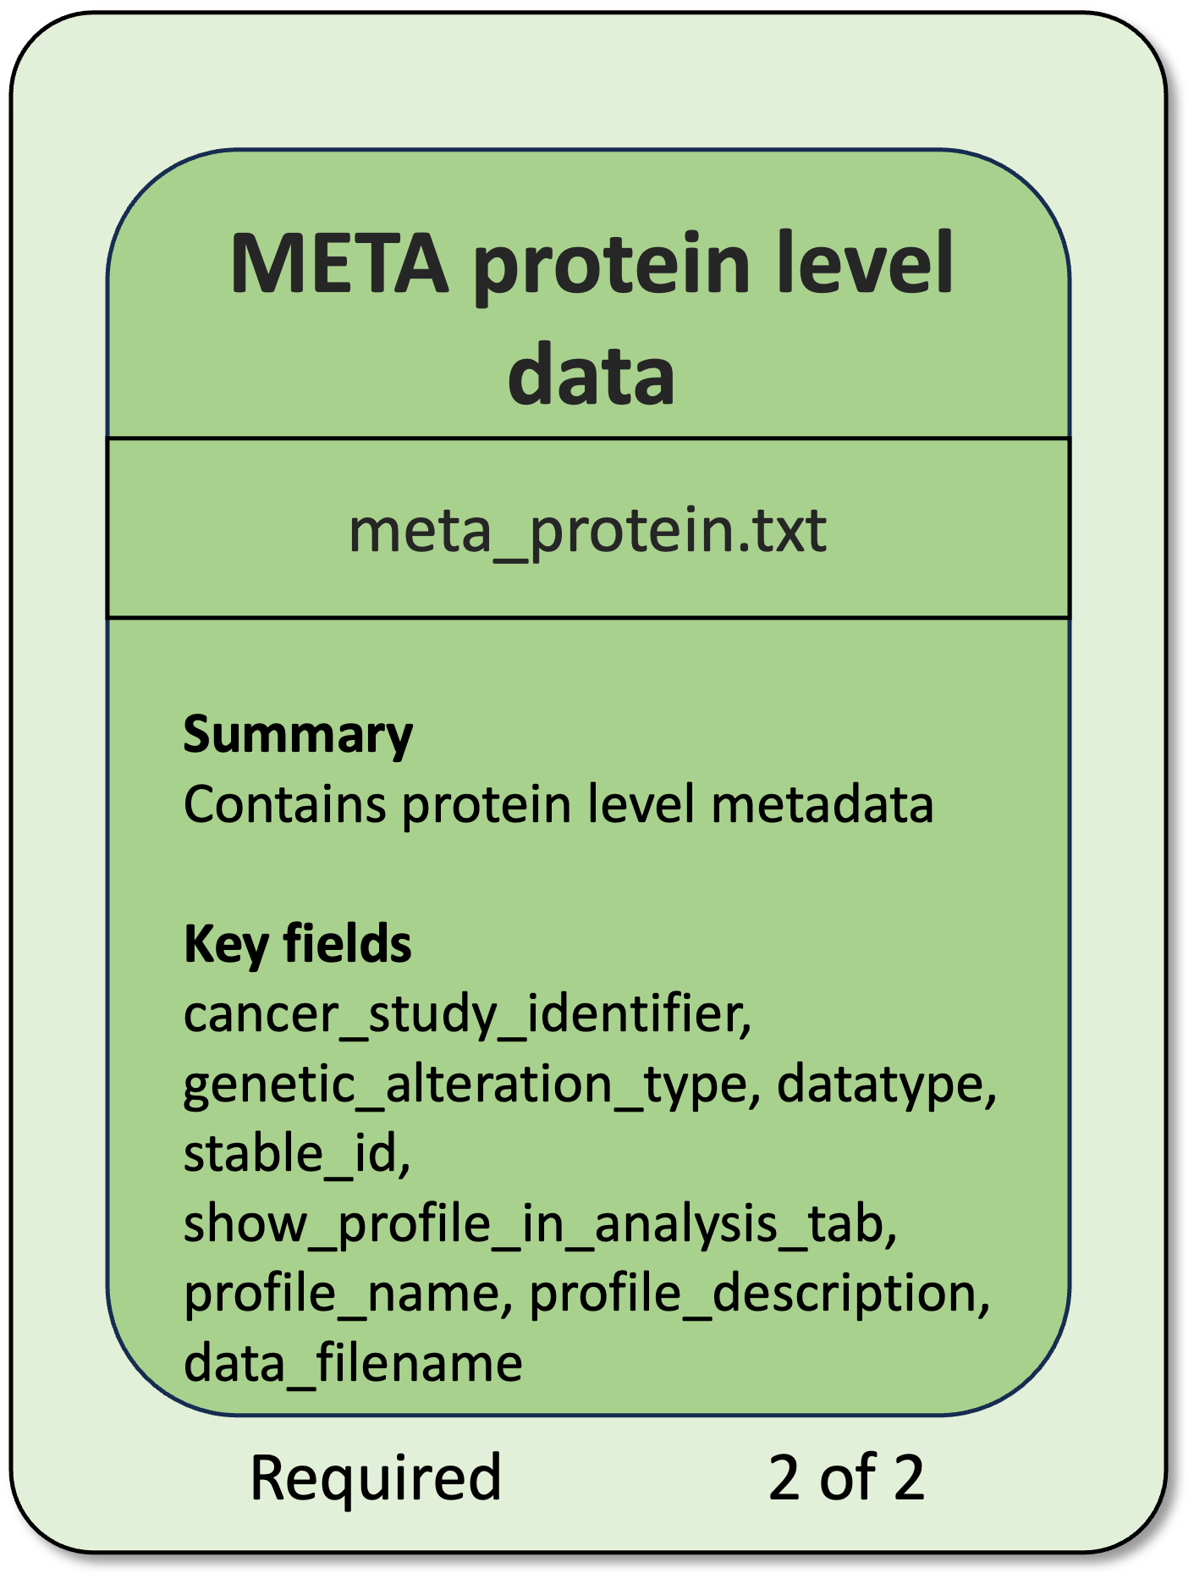
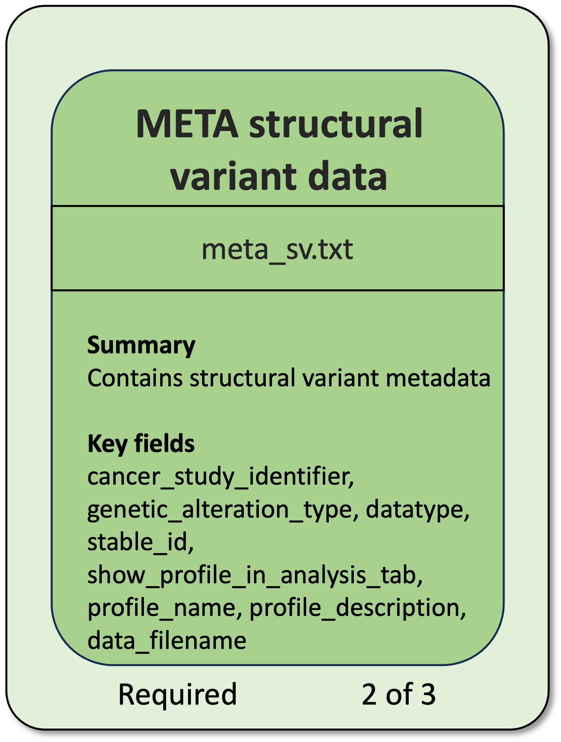
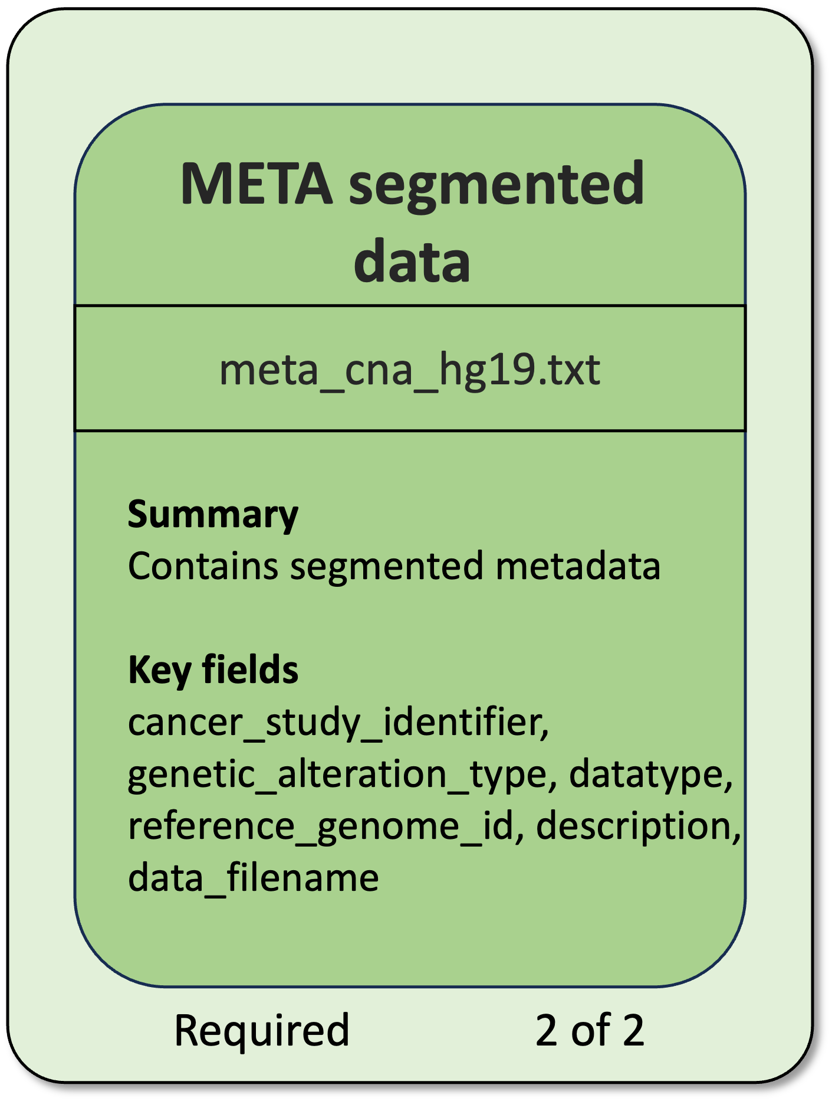
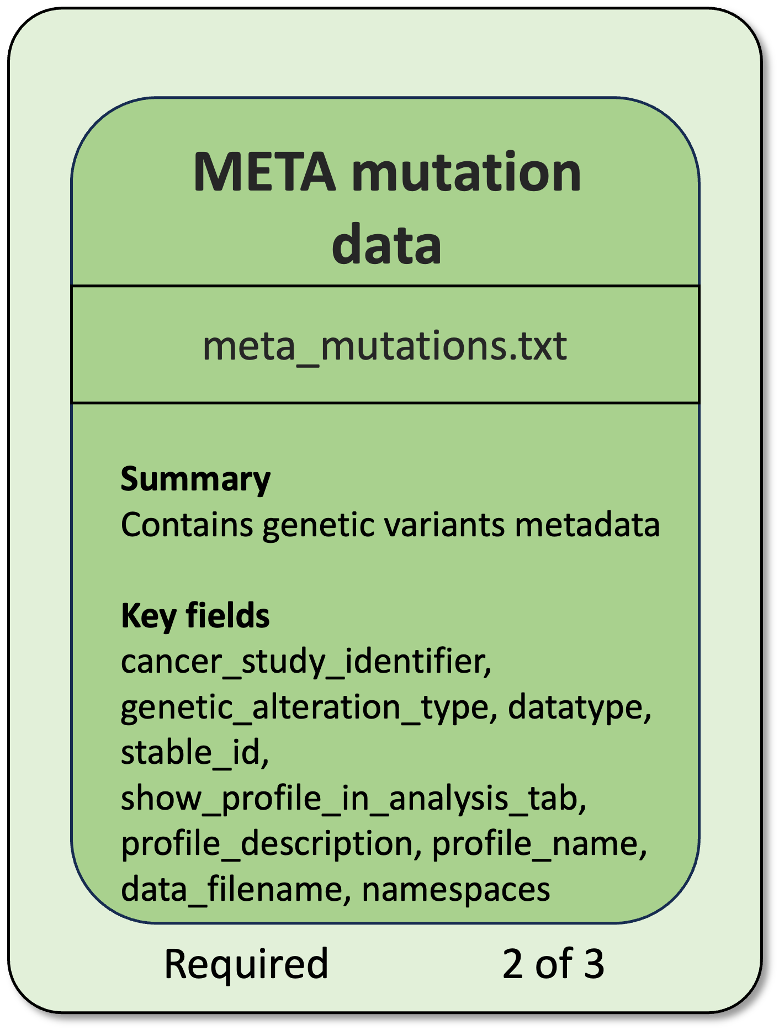
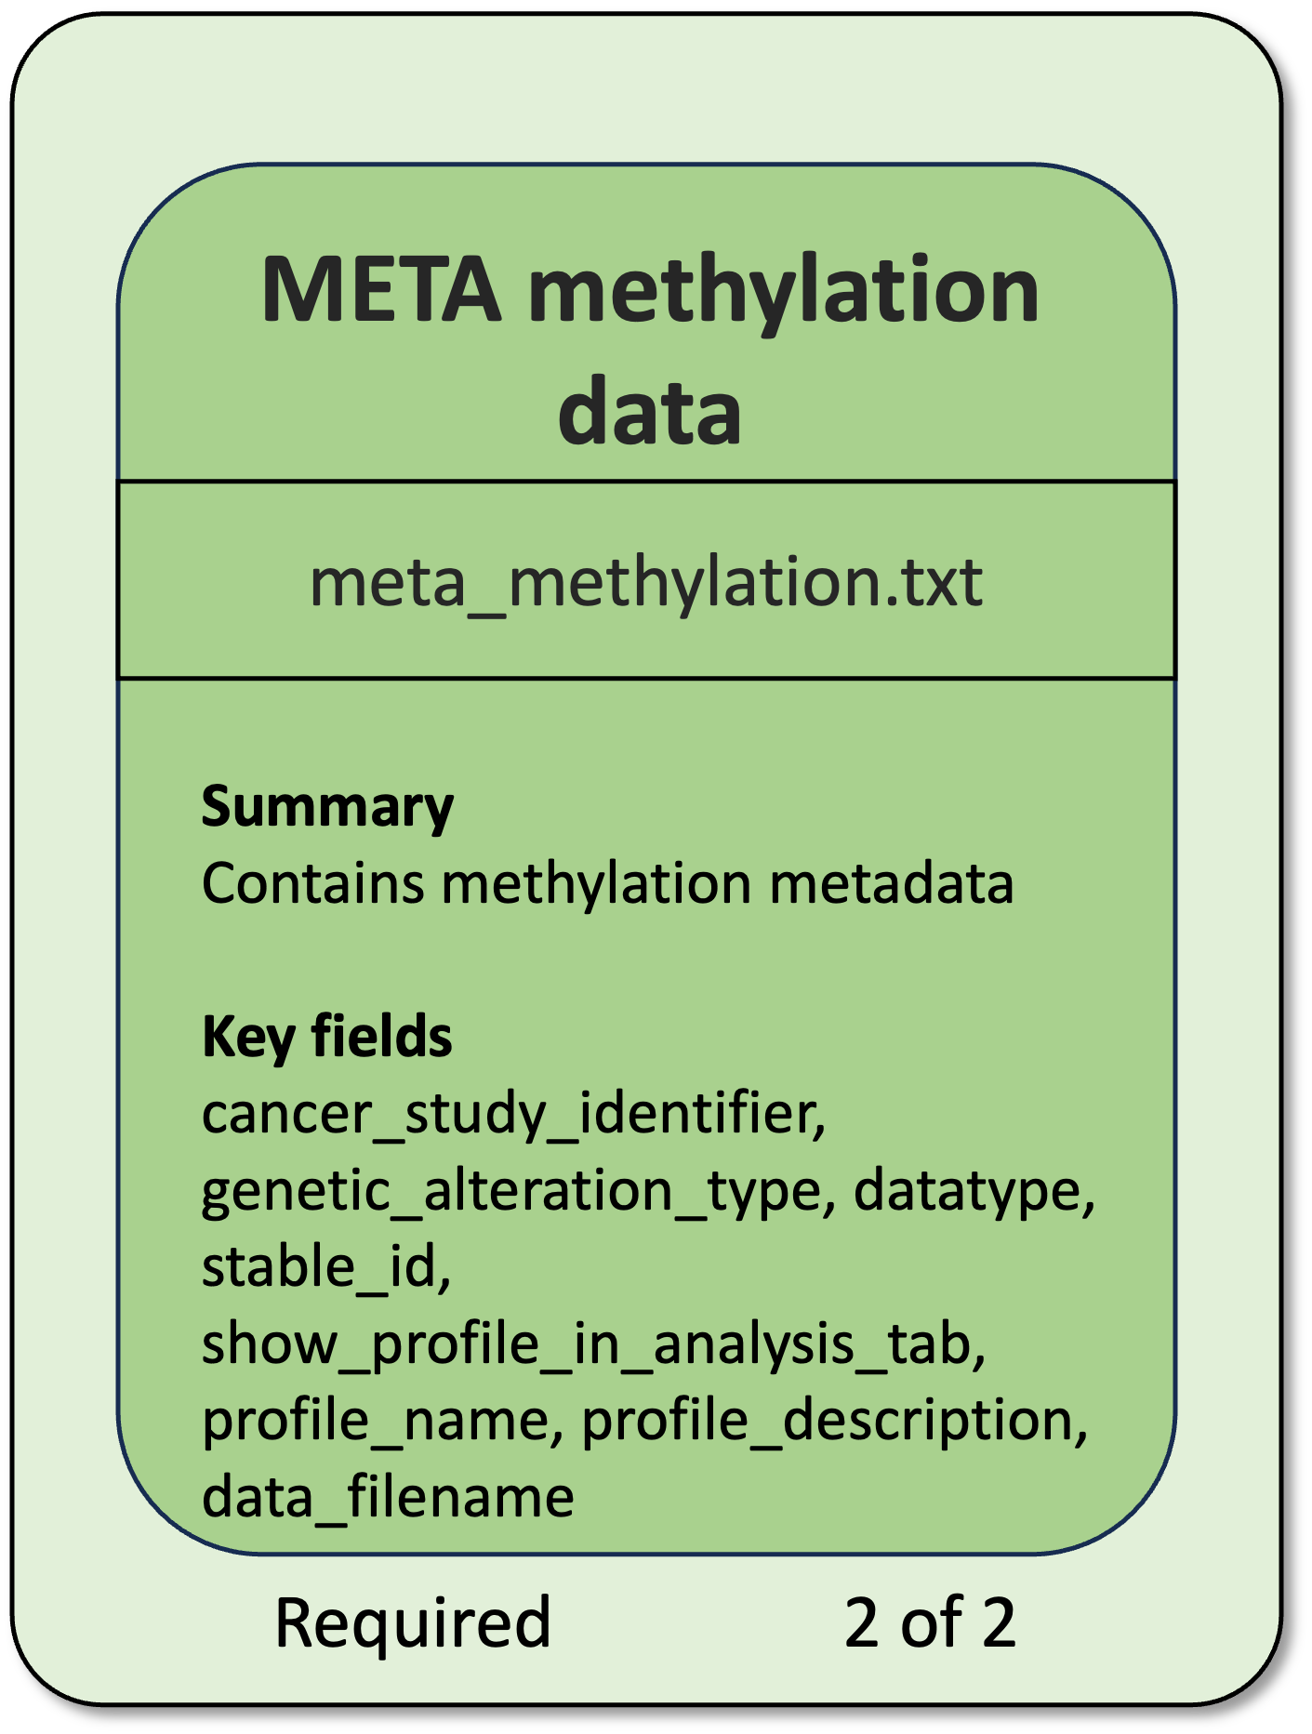
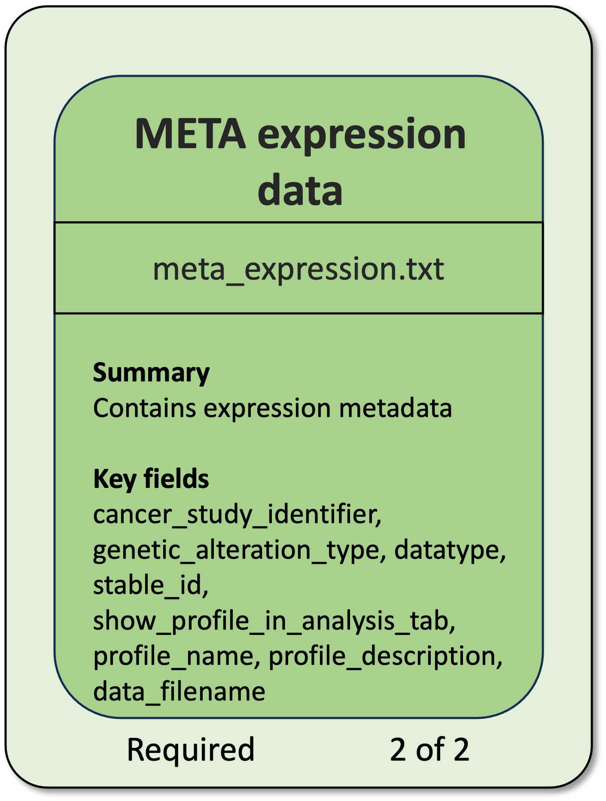
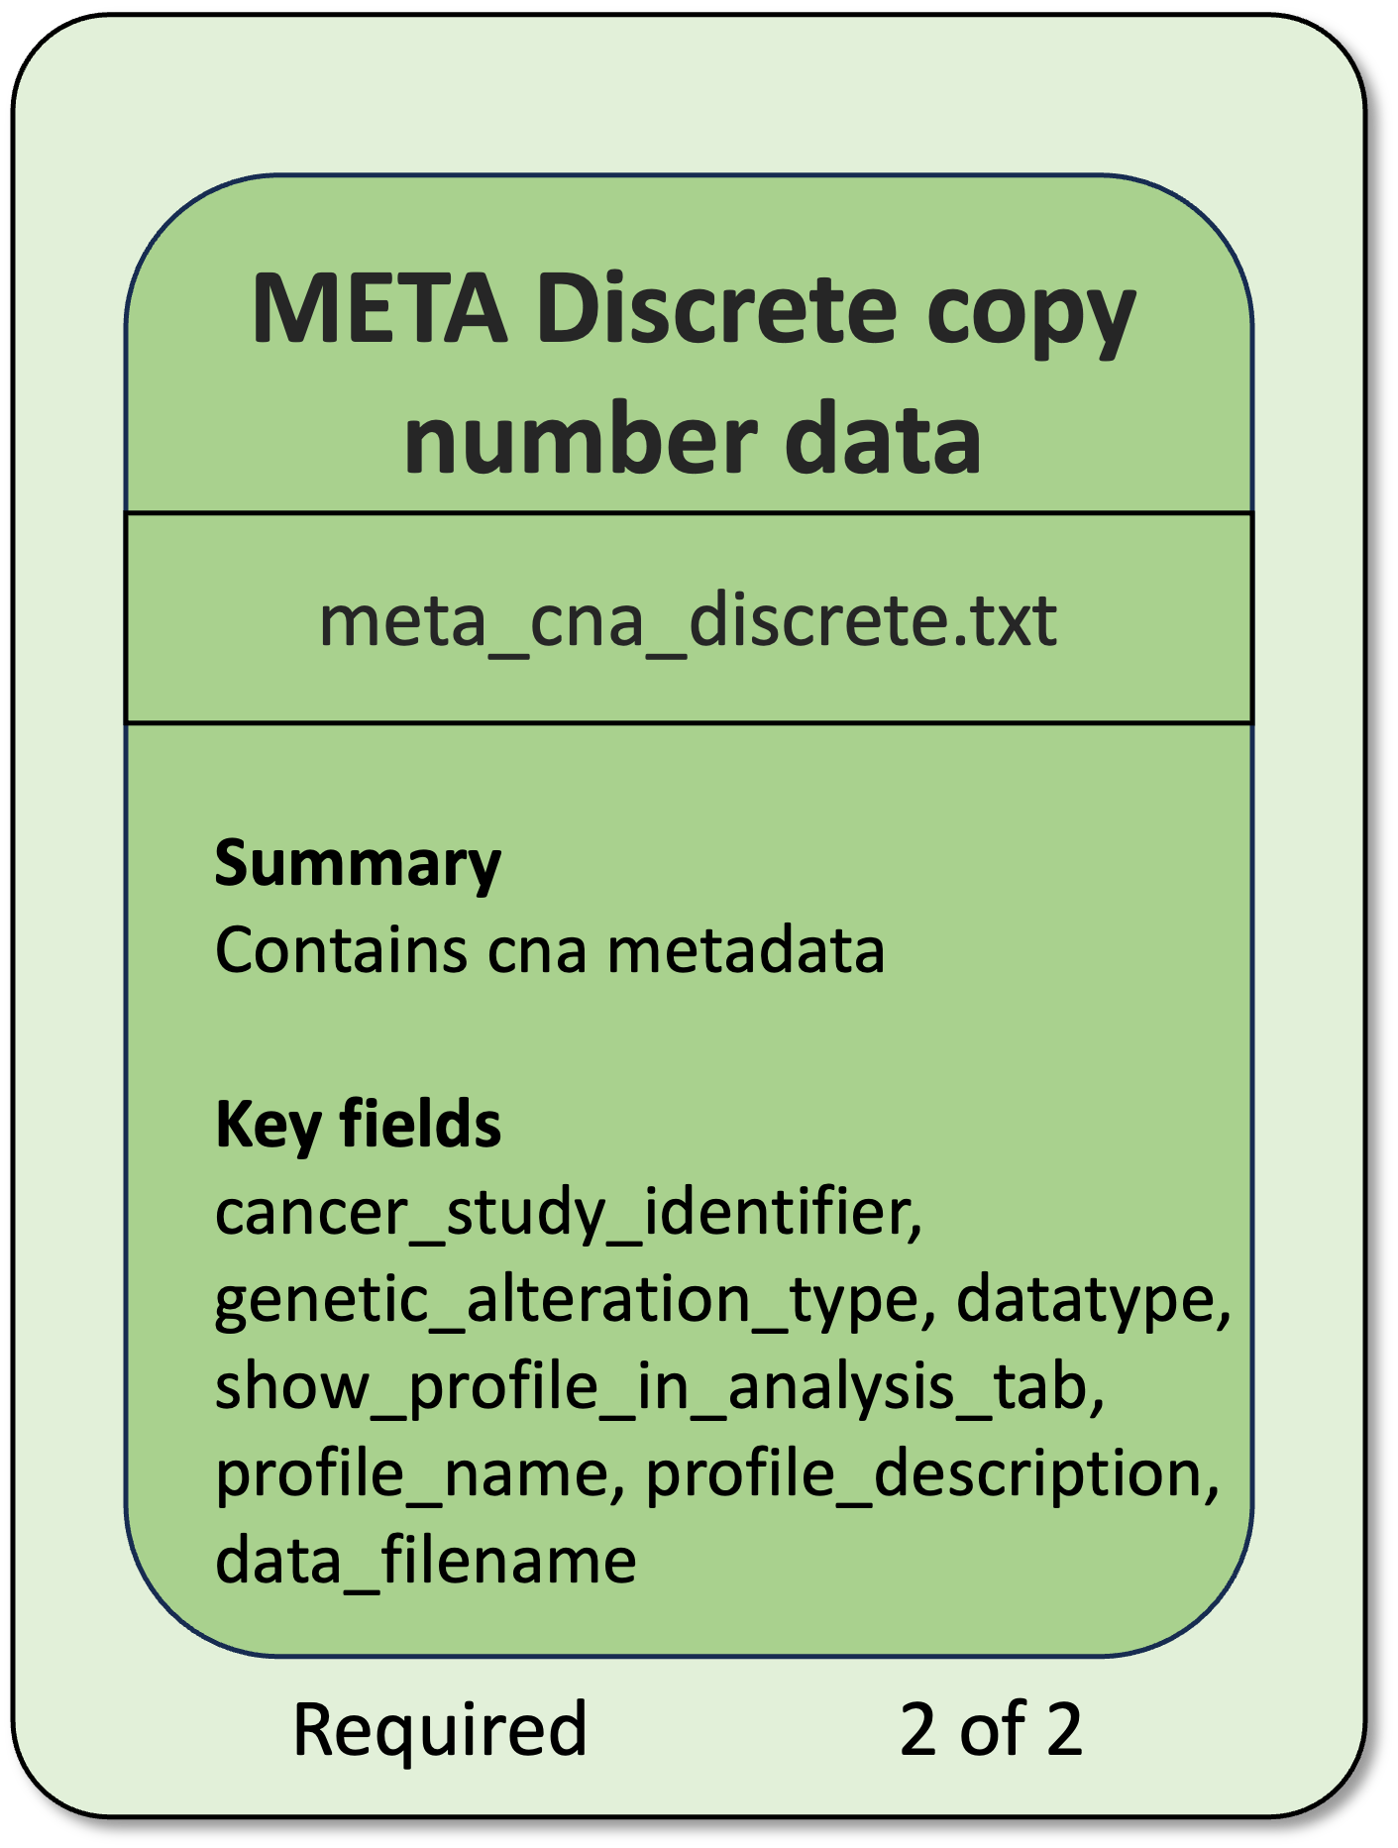
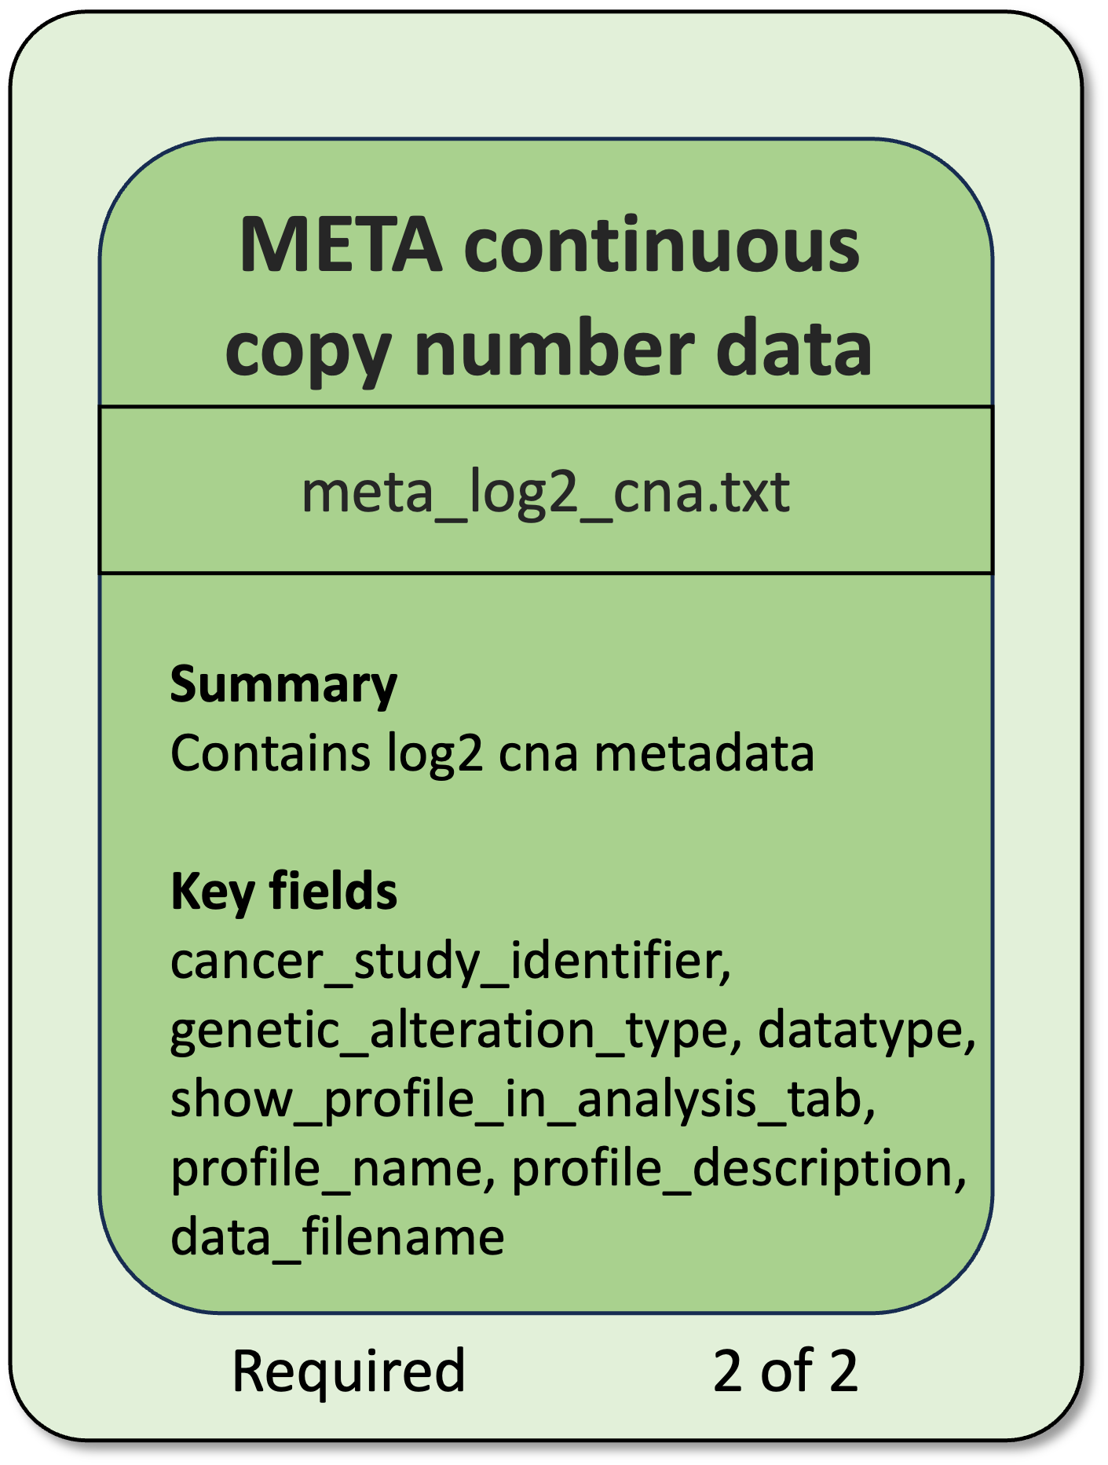
Select cards

Slide 36
Select cards

Slide 37
Build your decks
Use case: Blood Sample Monitoring in Study Alpha
Back ground:
Study Alpha involves the active collection of blood samples from cancer patients who meet specific inclusion criteria.
After finishing the collection period all blood samples have been sent to sequence and researcher got information of ctDNA levels, varant calling of mutations and SV and gene expression data.
Objective:
A researcher needs an intuitive and eficient tool to:
  Track and visualize the status of blood sample collection for all patients enrolled in the study.
  Follow up of the patient treatments.
  Filter and compare patients based on clinical characteristics (e.g., cancer type, stage, age, treatment received) to facilitate analysis and interpretation.
  Visualize changes of ctDNA during diferent blood collection moments.
  Compare groupd with diferent mutation/SV and check expression levels of the genes.

Slide 38
Select cards

Slide 39
Select cards

Slide 40
Study Alpha deck
x23 cards

Slide 41
Deck expansions
Data file | Description
GISTIC 2.0 Data | GISTIC can also provide amp_genes and del_genes files. These cannot be directly imported to cBioPortal, but it can be converted on a cBioPortal compatible format that complement the information on the copy number data
MutSig Data | MutSig analyzes list of mutations discovered on the DNA sequencing, to identify genes that were mutated more often than expected by chance given background mutation processes.
Gene Panel Data | Gene panels allows to specify which genes are assayed on a panel and assign samples and genetic profiles to a panel.
Gene Set Data | cBioPortal supports GSVA scores and GSVA-like scores data.
Study Tags file | YAML or JSON file which contains extra information about the cancer study
Generic Assay | Allows to create two dimensional matrix generalized to capture non-genetic measurements per sample (e.g. treatment response or mutational signatures)
Resource Data | Is used to capture resource data in patients, samples and studies. The resources will be represented by URLs with meta data.

