Slide 1



cBioPortal as a Data Integration Platform
Introduction for the STEPUPIORS workshop
dr. ir. Mariska Bierkens
Associate Staff Scientist
Department of Pathology
Translational Gastrointestinal Oncology
The Netherlands Cancer Institute
m.bierkens@nki.nl
4 June 2025

Slide 2



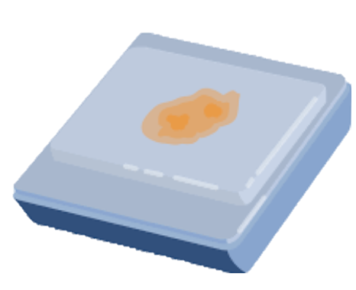







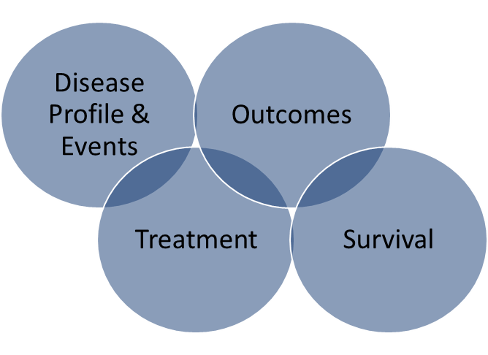
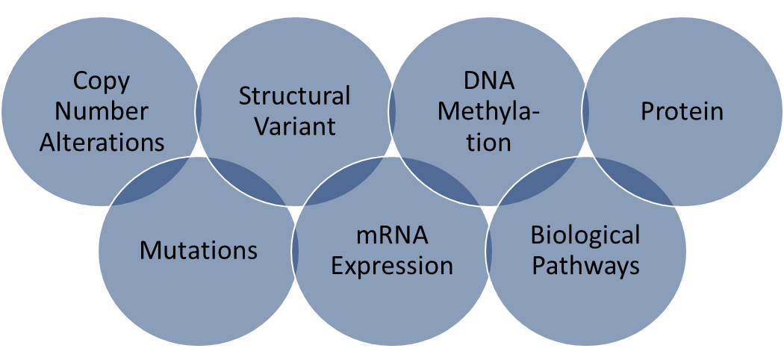

Cancer Data
Data Capturing Platforms
Informed Consent
Clinical Characteristics
Imaging
Biosamples & Derivatives
Pathology
Molecular Profiling
PROMs
Patient Reported Outcome Measures
Integration, Analysis & Visualisation
This study was funded by the Horizon Europe Twinning Project STEPUPIORS - 101079217

Slide 3
Cancer Data in cBioPortal
Data Capturing Platforms
Informed Consent
Clinical Characteristics
Imaging
Biosamples & Derivatives
Pathology
Molecular Profiling
PROMs
Patient Reported Outcome Measures
Integration, Analysis & Visualisation
Data integration platform
This study was funded by the Horizon Europe Twinning Project STEPUPIORS - 101079217

Slide 4
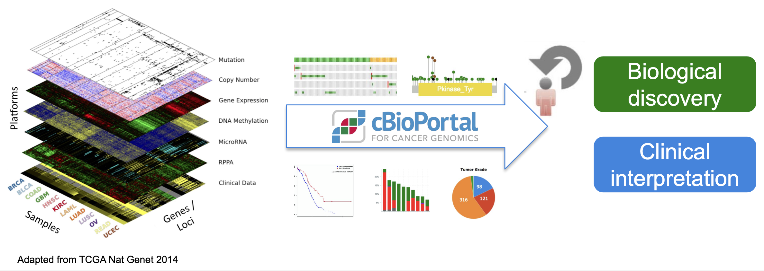
The cBioPortal for Cancer Genomics
Make complex cancer genomic data accessible and interpretable for cancer biologists and clinicians
Cerami et al. Cancer Discovery 2012
Gao et al. Science Signaling 2013
This study was funded by the Horizon Europe Twinning Project STEPUPIORS - 101079217

Slide 5

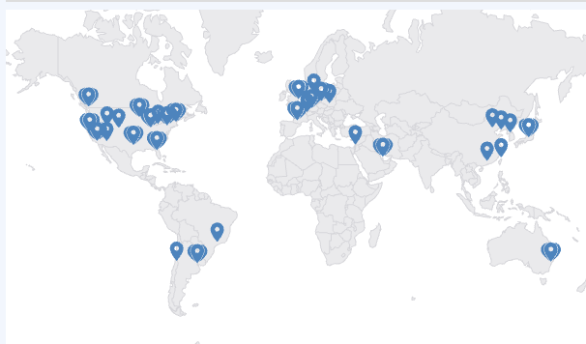
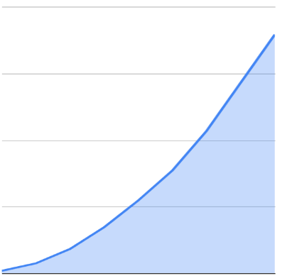
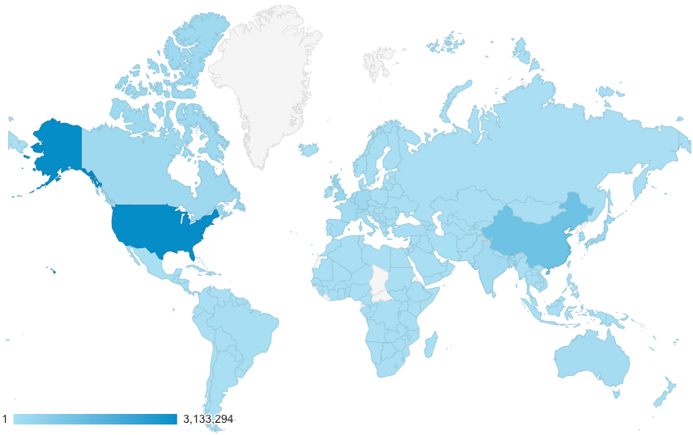
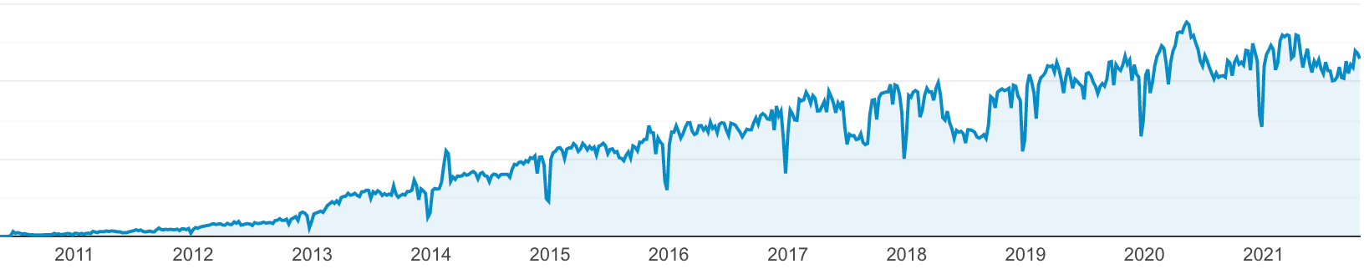























over time
https://cbioportal.org
Citations
Curated Studies
20k
>480
15k
>86 local installatons
Monthly Users
10k
30,000
~34k
> 7,000,000 visits to cBioPortal.org since 2011
Total Citations
5k
~18k
0
20,000
2014
2016
2018
2020
Weekly user visits
10,000
2006
2008
Start of cBioPortal
Query/Results view
Patient View Study View
Open source transition
(MSK, DFCI & Hyve)
PMCC &
CHOP joined
Architecture upgraded
Comparison View
First SU2C
cBioPortal
Gao et al.
Sci Signal.
Start of HTAN
Webinars
Cerami et al.
Cancer Discov.
Project GENIE
GENIE BPC
cBioPortal @MSK
cBioPortal @DFCI
ITCR funding
Count Me In
Start of TCGA
cBioPortal @PMCC
cBioPortal @CHOP
This study was funded by the Horizon Europe Twinning Project STEPUPIORS - 101079217
Notes:
Developed initially at Memorial Sloan Kettering Cancer Center (MSK), a.o. JJ Gao, Niki Schultz; public site hosted by MSK (who wanted to get insight into what data do they have – and they wanted to empower the researchers in being able to perform queries themselves
Started with TCGA data, has been growing ever since
Since 2015 cBioPortal software is available under an open source license via GitHub
software is now developed and maintained by a multi-institutional team, consisting of MSK, the Dana Farber Cancer Institute, Princess Margaret Cancer Centre in Toronto, Children's Hospital of Philadelphia, The Hyve in the Netherlands, and Bilkent University in Ankara, Turkey.

Slide 6






Cancer Data in cBioPortal
Data Capturing Platforms
Informed Consent
Clinical Characteristics
Imaging
Biosamples & Derivatives
Pathology
Molecular Profiling
PROMs
Patient Reported Outcome Measures
Integration, Analysis & Visualisation
Databases for annotations of variants
Precision oncology knowledge base
Clinical Interpretation
Variant recurrence
Biological Discovery
This study was funded by the Horizon Europe Twinning Project STEPUPIORS - 101079217

Slide 7
Cancer Data in cBioPortal
Data Capturing Platforms
Informed Consent
Clinical Characteristics
Imaging
Biosamples & Derivatives
Pathology
Molecular Profiling
PROMs
Patient Reported Outcome Measures
Integration, Analysis & Visualisation
Clinical Interpretation
Explore the datasets on:
Study level (a.o. group comparison)
Patient level
Gene level
Biological Discovery
This study was funded by the Horizon Europe Twinning Project STEPUPIORS - 101079217

Slide 8
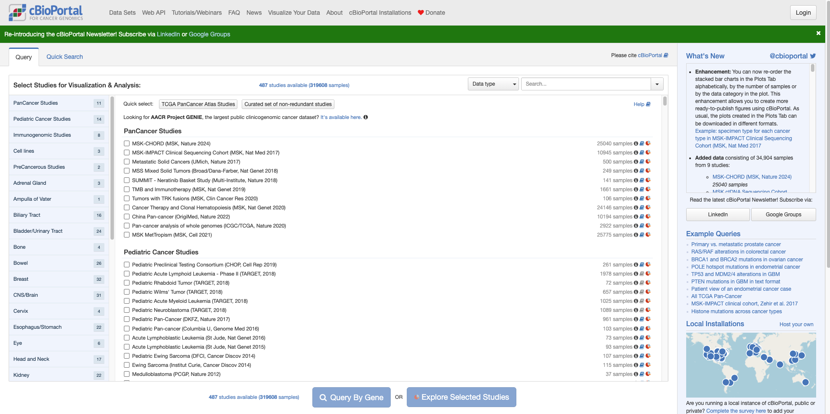
Studies Overview
This study was funded by the Horizon Europe Twinning Project STEPUPIORS - 101079217

Slide 9
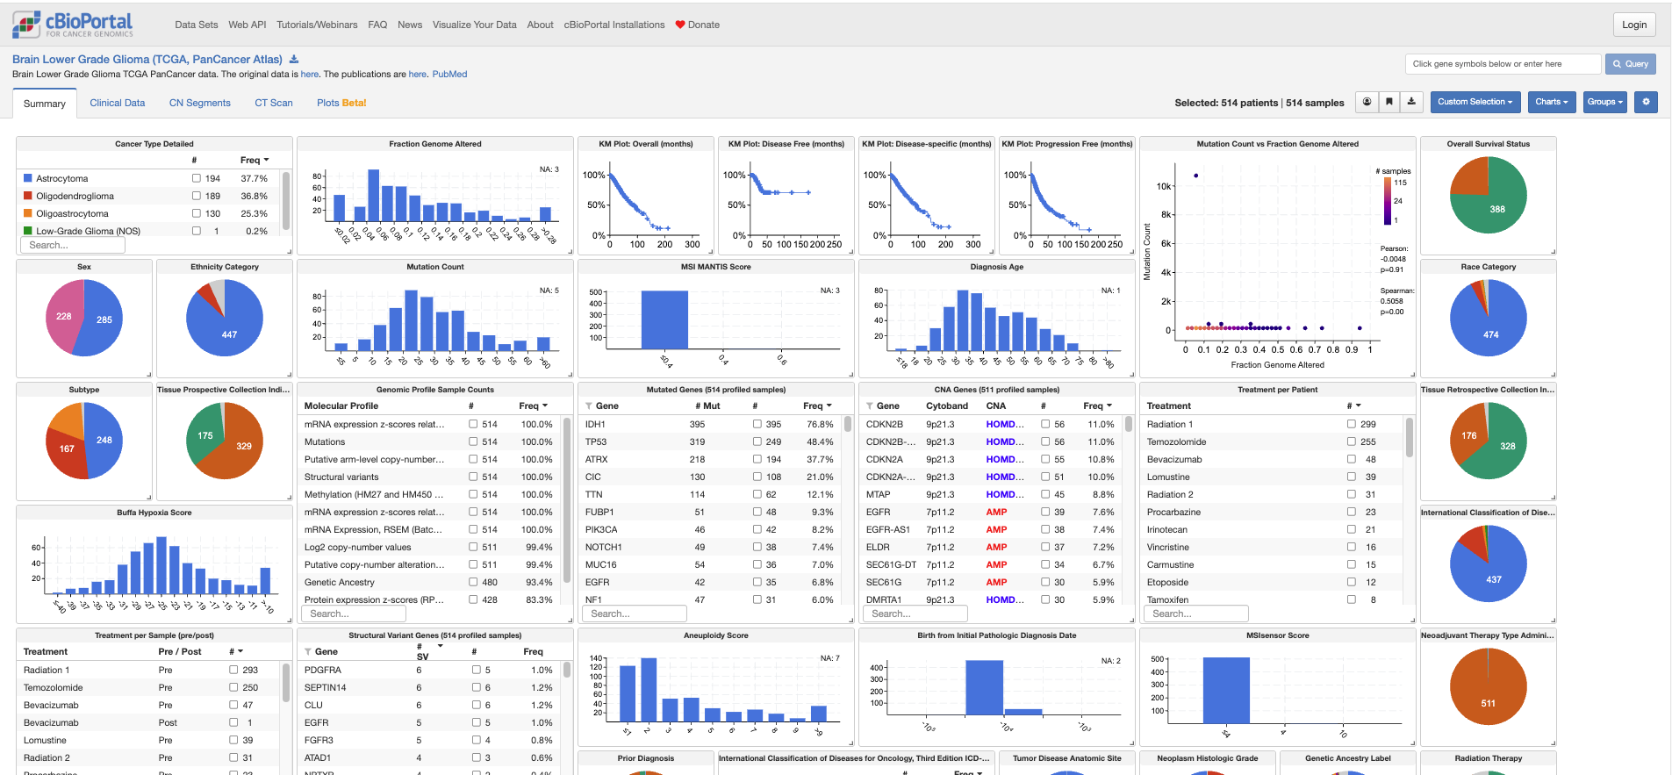
1. Study Level: Overview
This study was funded by the Horizon Europe Twinning Project STEPUPIORS - 101079217

Slide 10
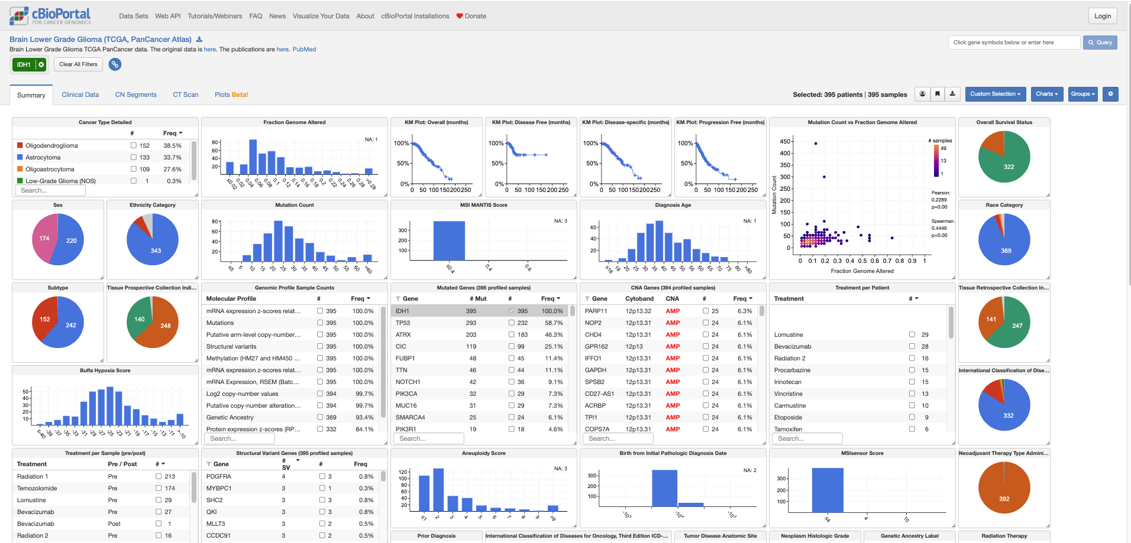
1. Study Level: Filter for (a) subset(s)
This study was funded by the Horizon Europe Twinning Project STEPUPIORS - 101079217

Slide 11
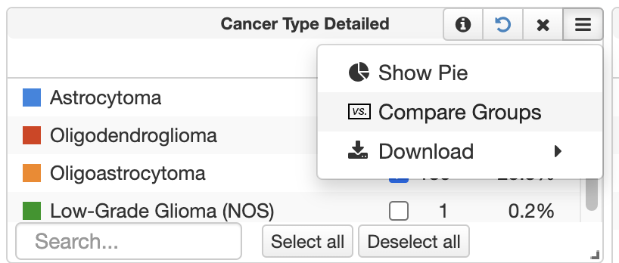
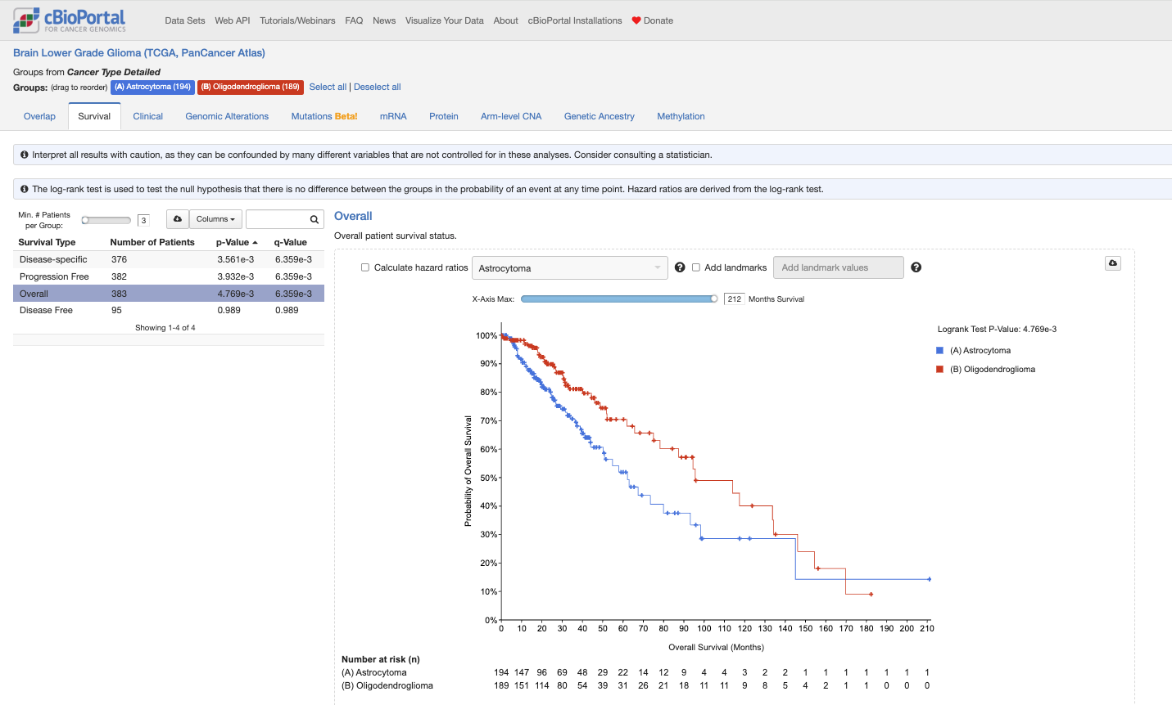
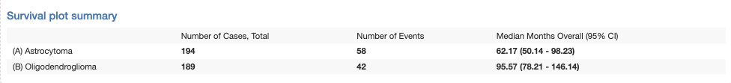
1. Study Level: Group-Cohort Comparison
This study was funded by the Horizon Europe Twinning Project STEPUPIORS - 101079217

Slide 12
1. Study Level: Overview
This study was funded by the Horizon Europe Twinning Project STEPUPIORS - 101079217

Slide 13
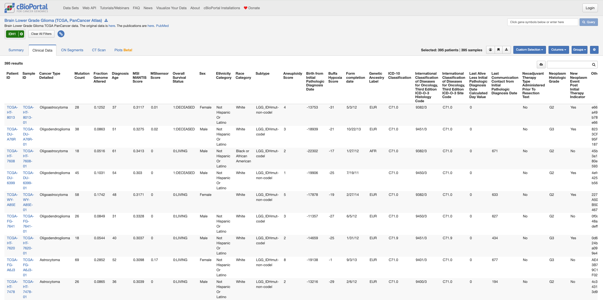
1. Study Level: Clinical Data
This study was funded by the Horizon Europe Twinning Project STEPUPIORS - 101079217

Slide 14
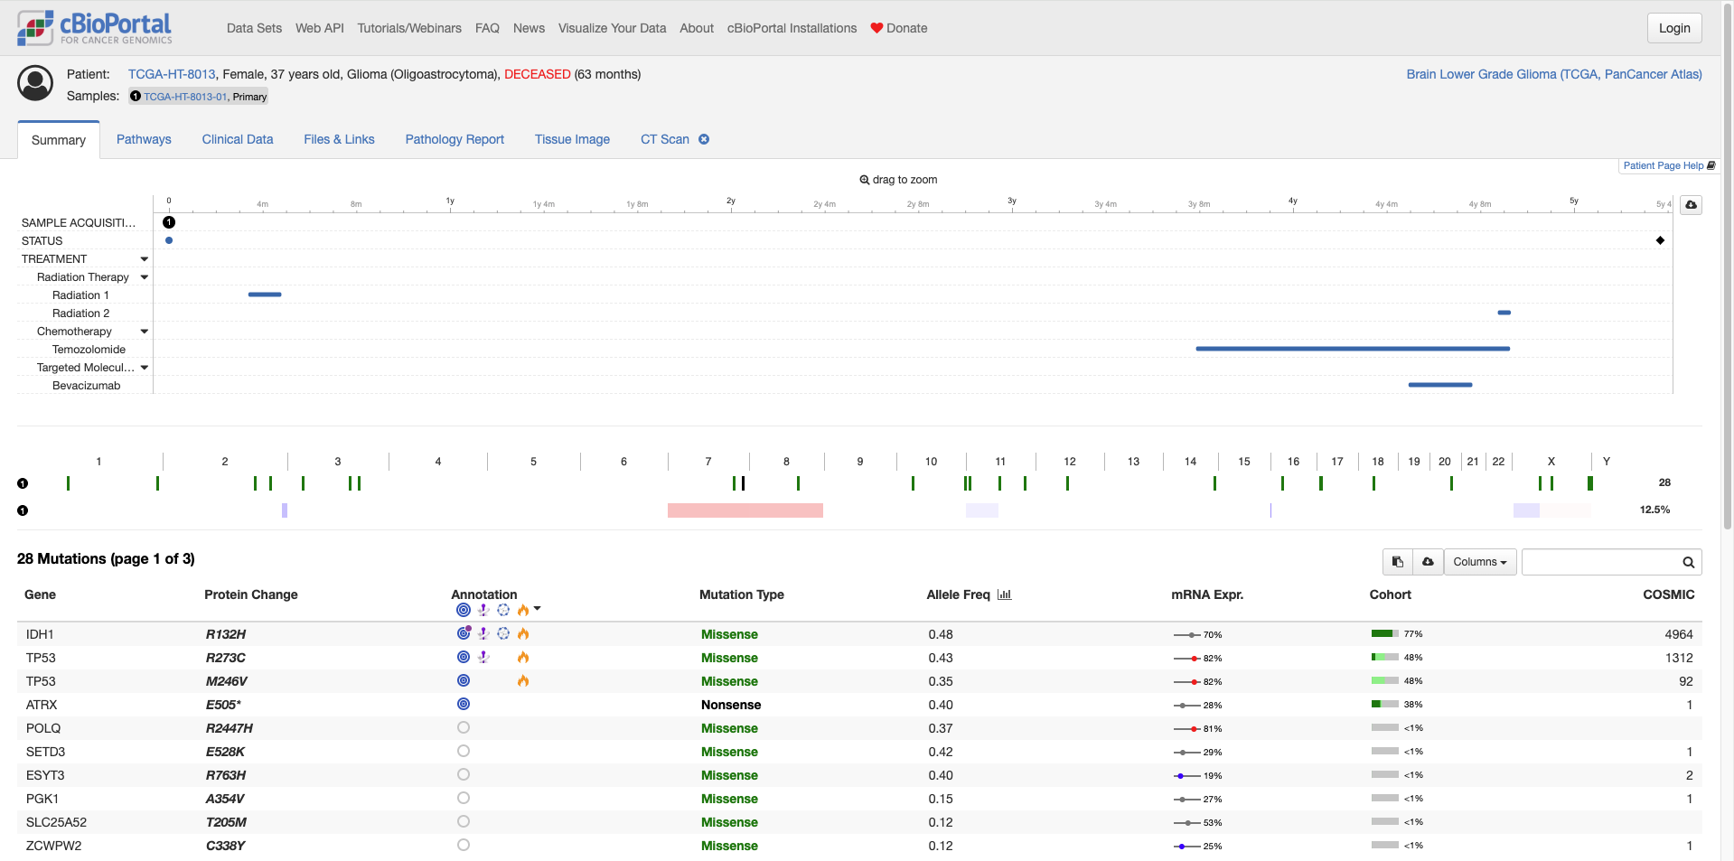
1. Study Level: Clinical Data
This study was funded by the Horizon Europe Twinning Project STEPUPIORS - 101079217

Slide 15
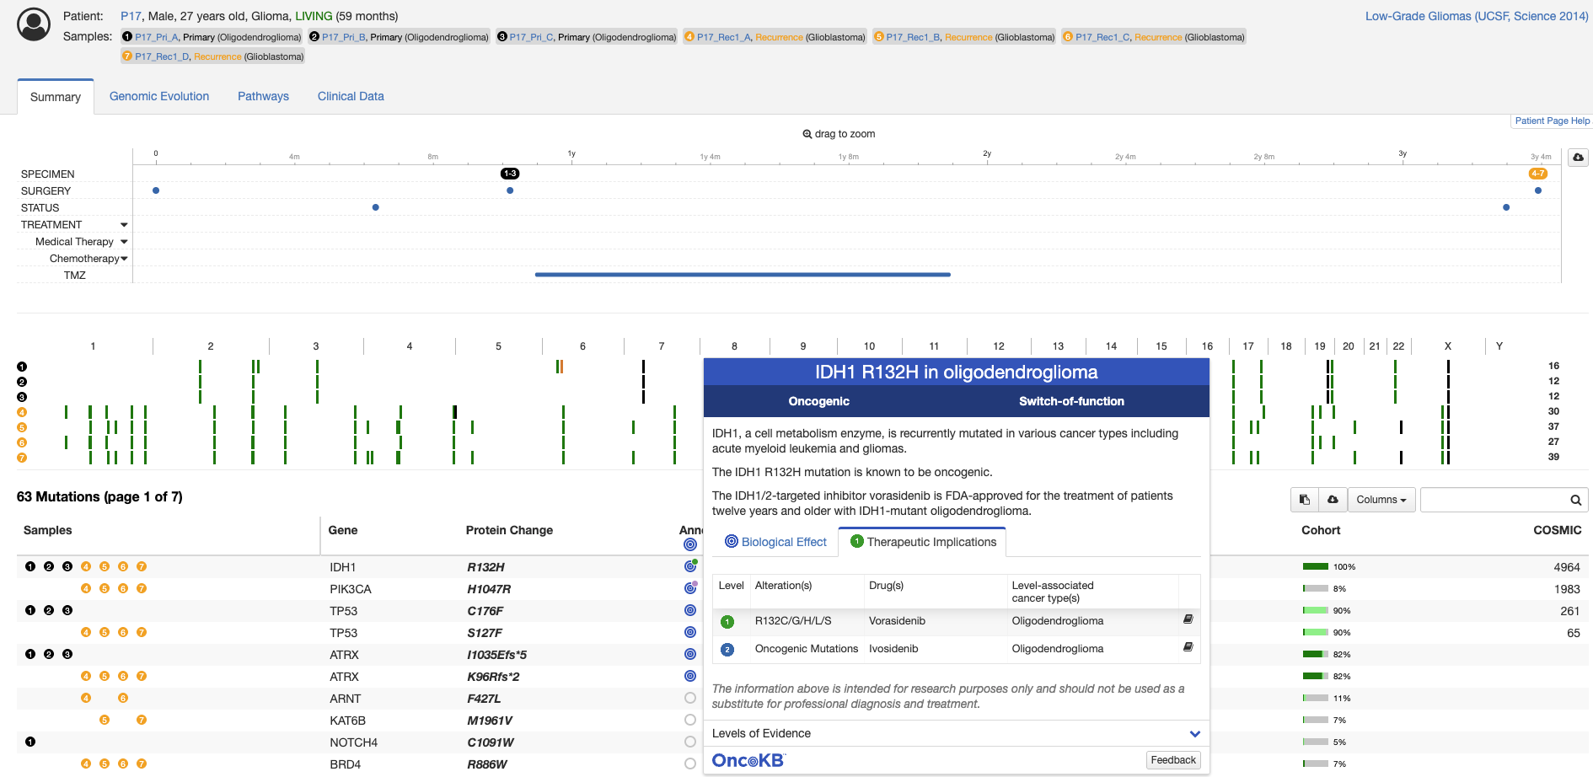
2. Patient Level
This study was funded by the Horizon Europe Twinning Project STEPUPIORS - 101079217

Slide 16
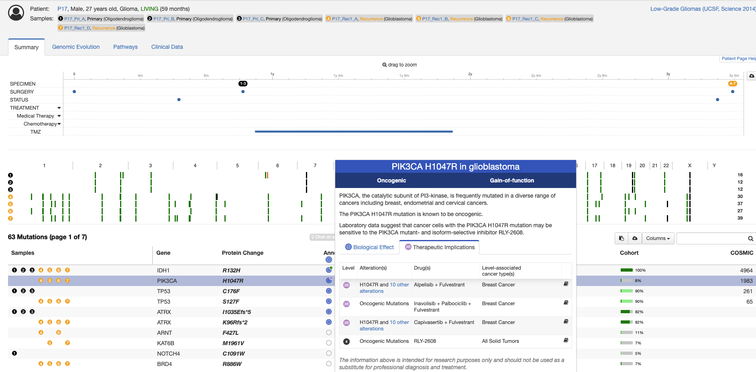
2. Patient Level
This study was funded by the Horizon Europe Twinning Project STEPUPIORS - 101079217

Slide 17
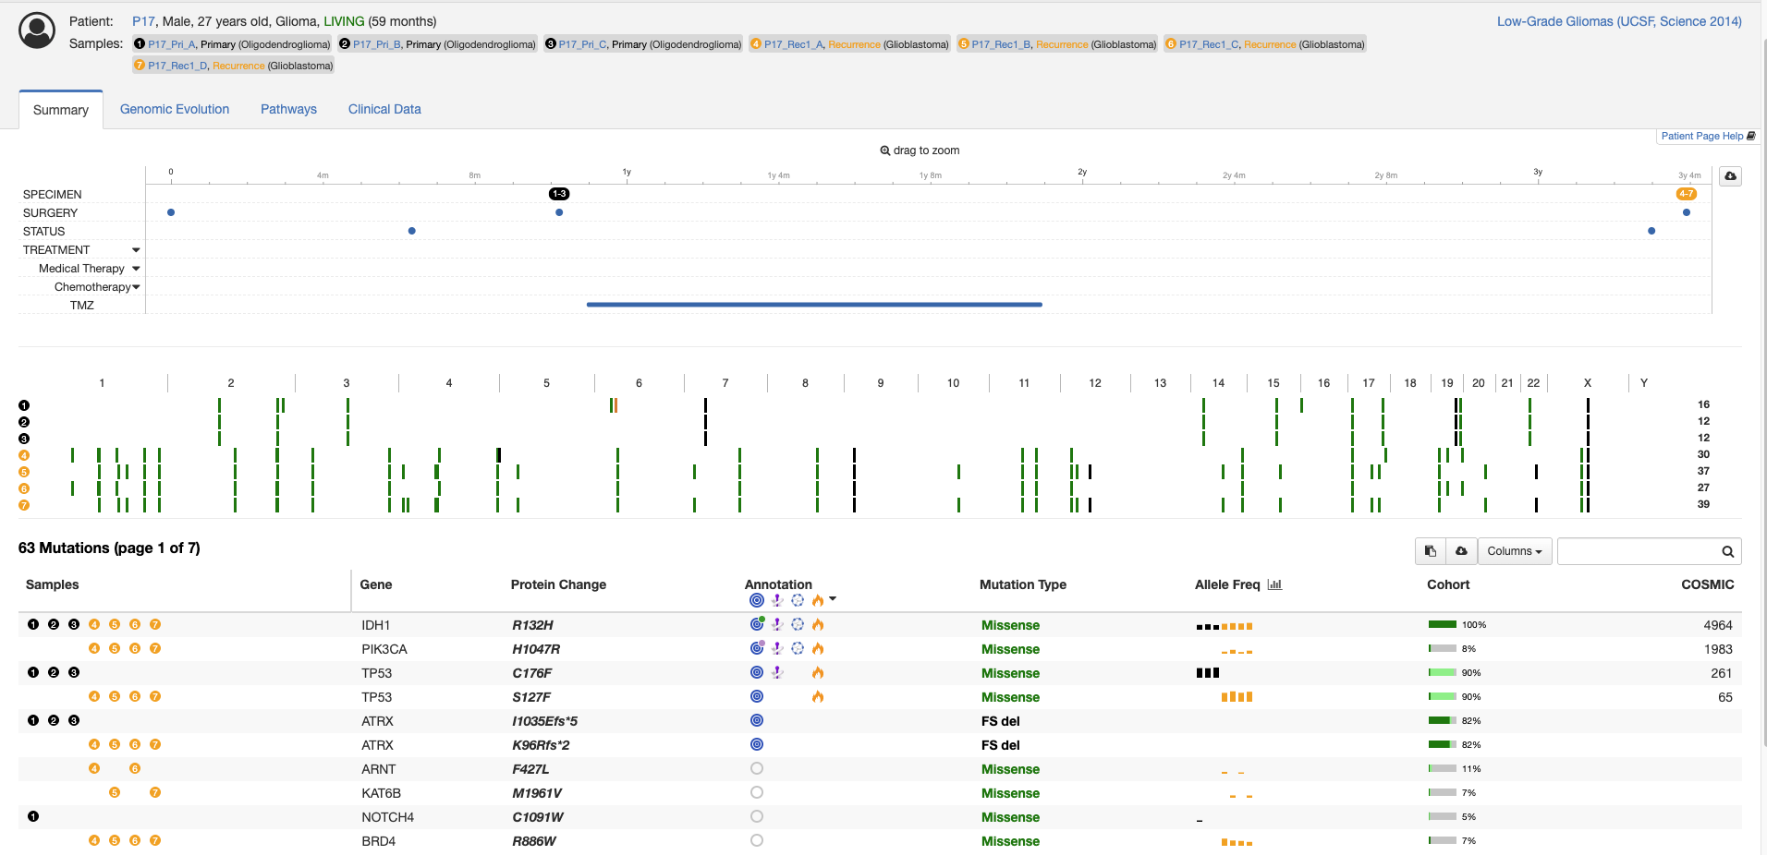
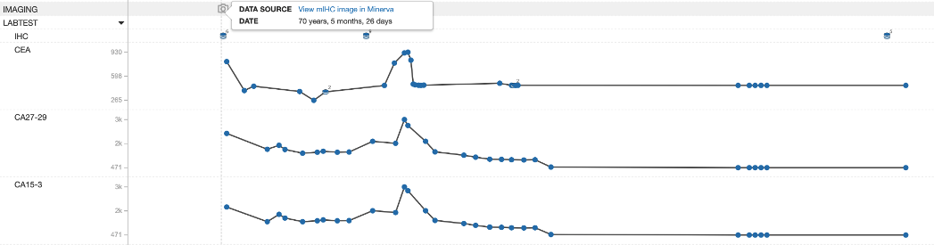
2. Patient Level
This study was funded by the Horizon Europe Twinning Project STEPUPIORS - 101079217

Slide 18

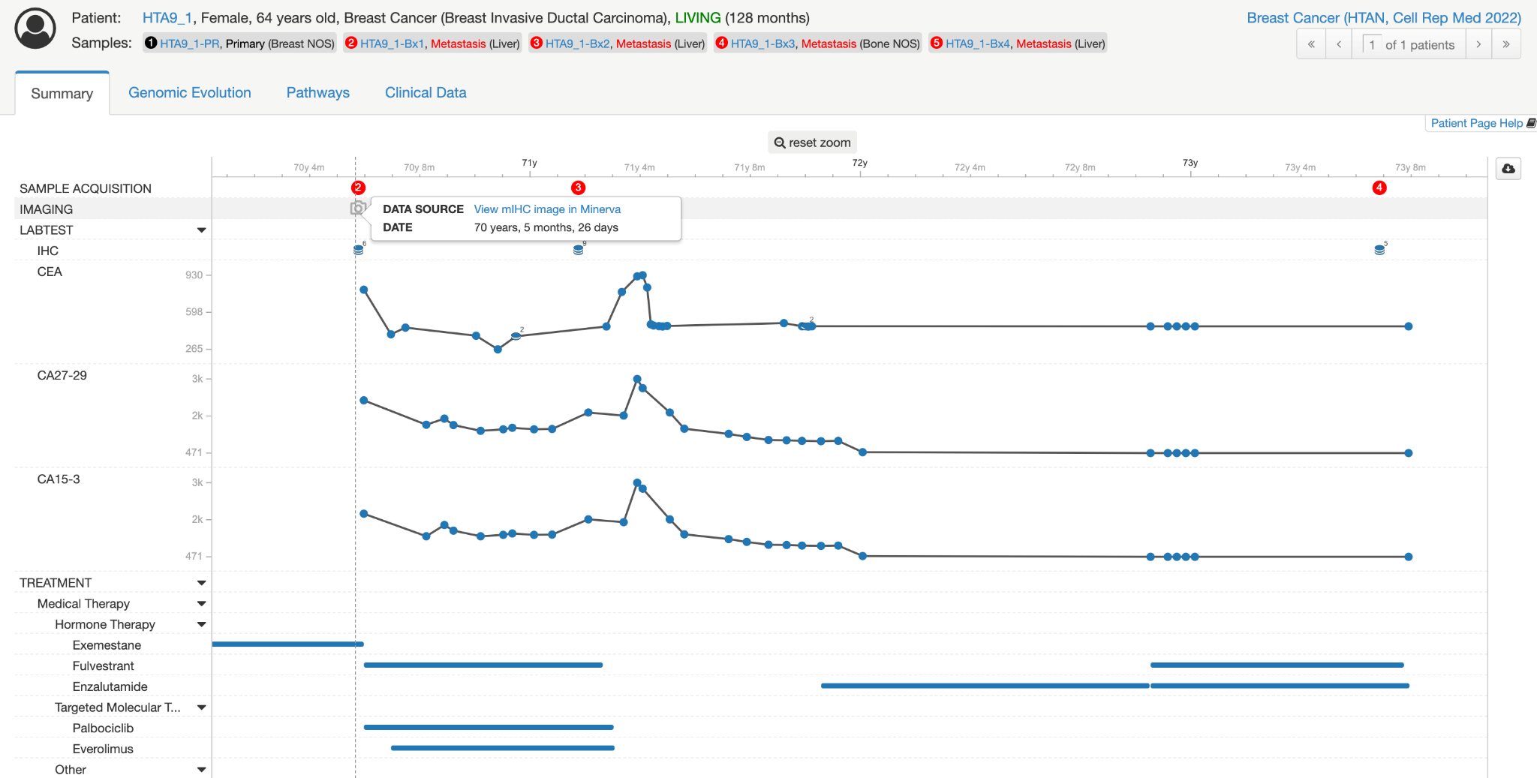
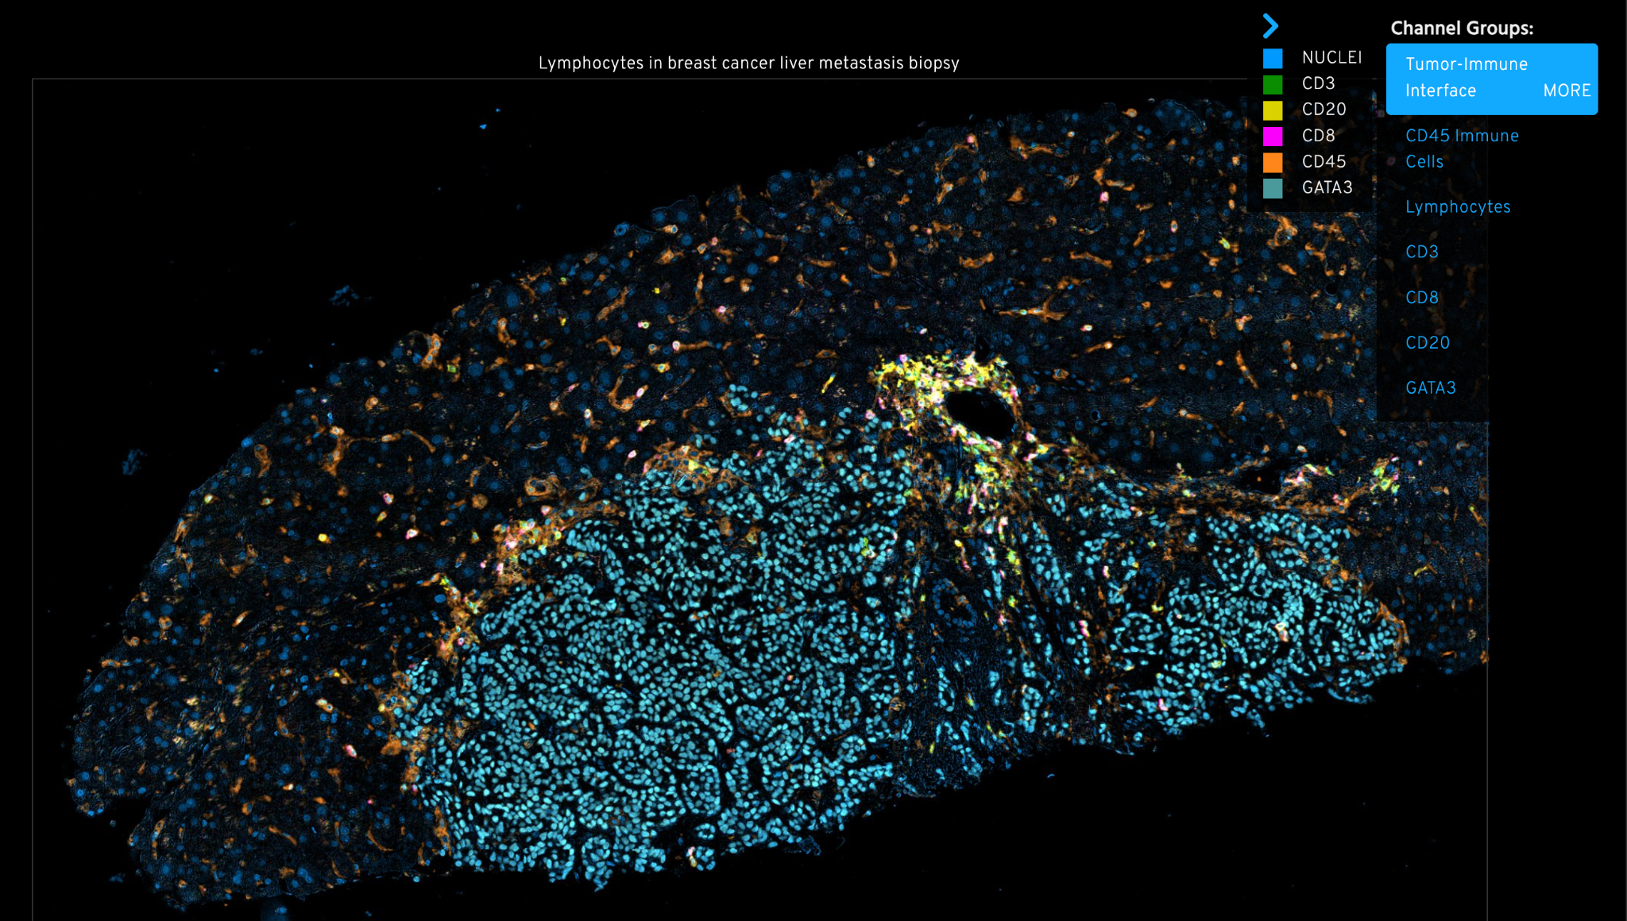
2. Patient Level – link to other sources
Minerva
cbioportal.org
Link
This study was funded by the Horizon Europe Twinning Project STEPUPIORS - 101079217
Notes:
https://www.cbioportal.org/patient?studyId=brca_hta9_htan_2022&caseId=HTA9_1

Slide 19
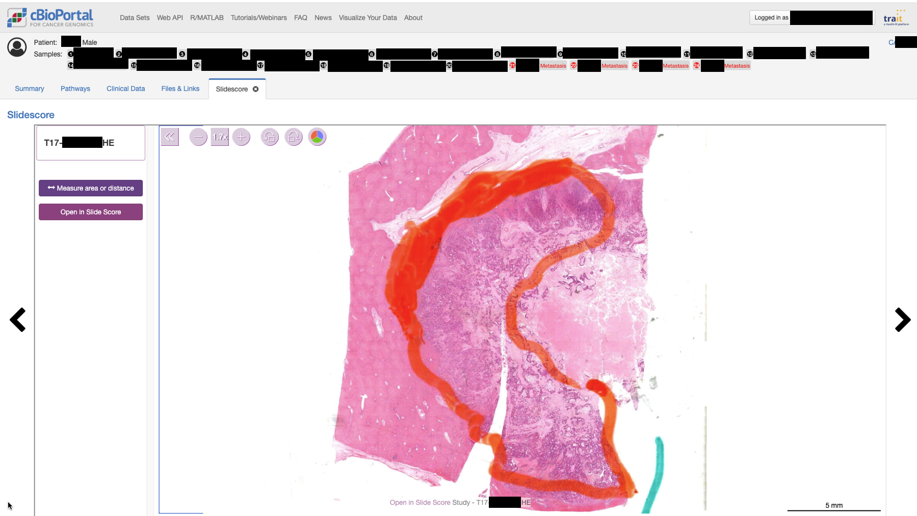
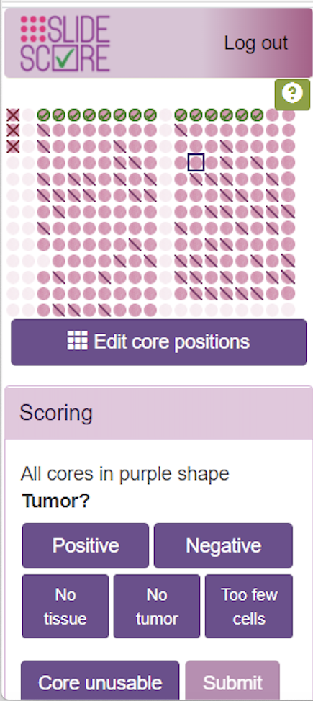
2. Patient Level – link to other sources
SlideScore (and other tools like DSA, Xopat): connection already possible
This study was funded by the Horizon Europe Twinning Project STEPUPIORS - 101079217

Slide 20
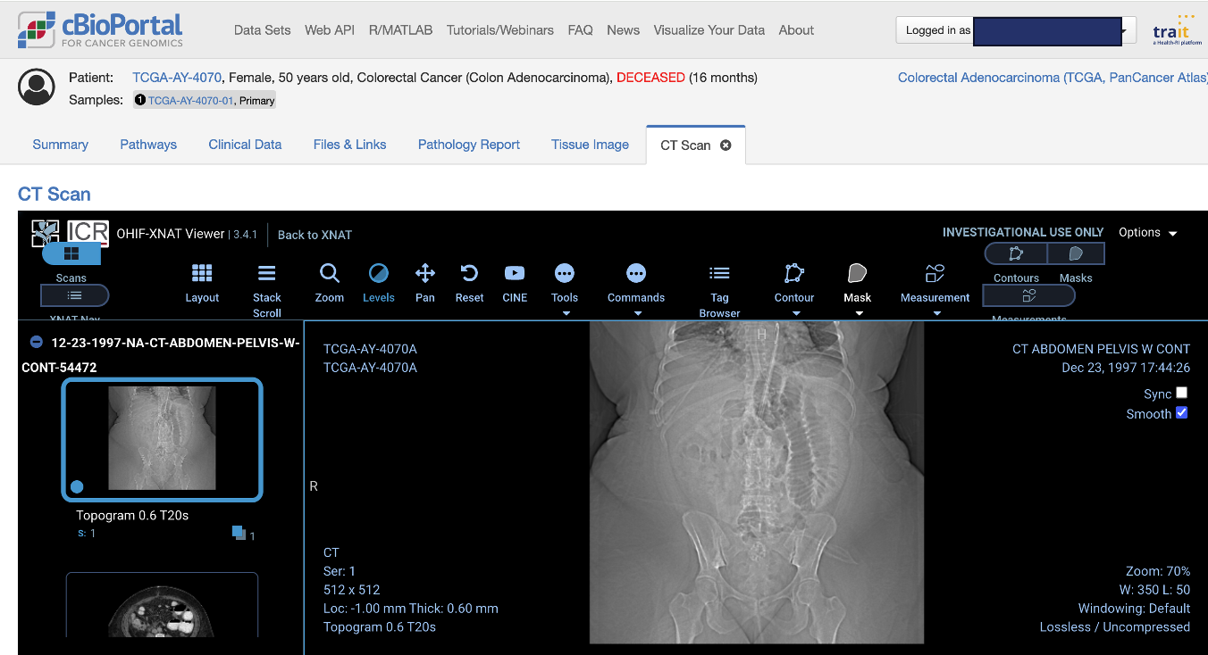
2. Patient Level – link to other sources
XNAT: connection already possible
This study was funded by the Horizon Europe Twinning Project STEPUPIORS - 101079217

Slide 21
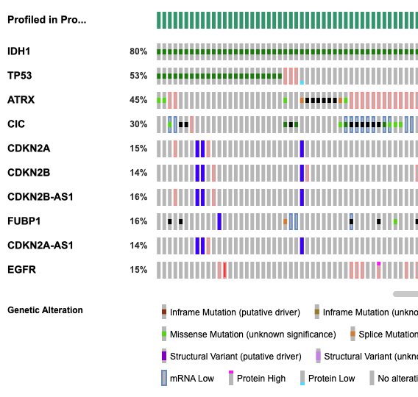
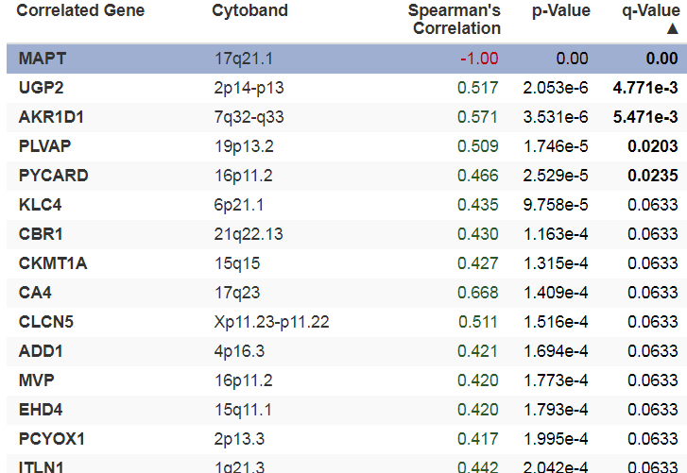
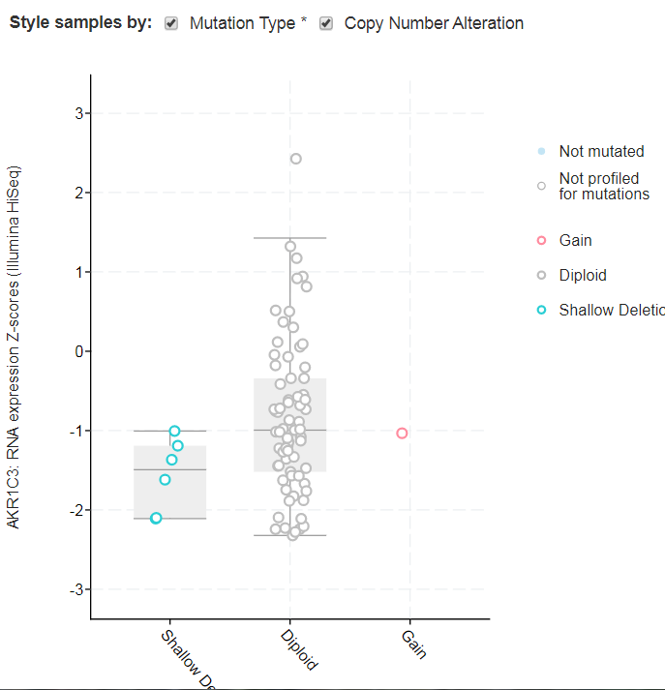
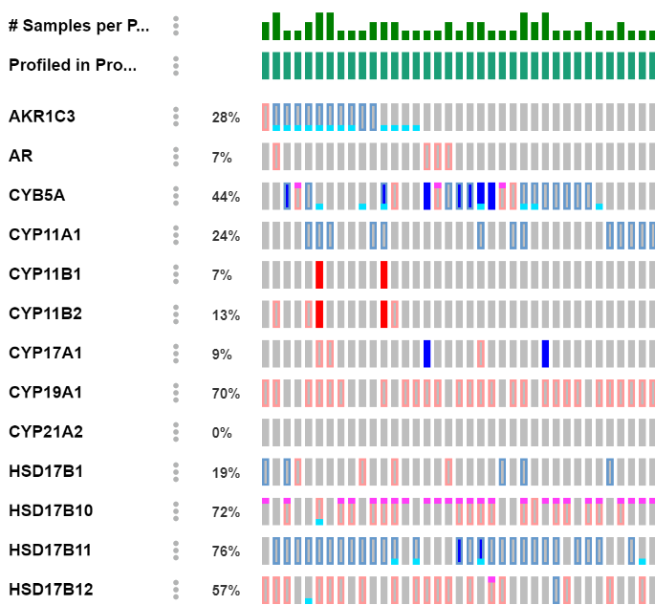
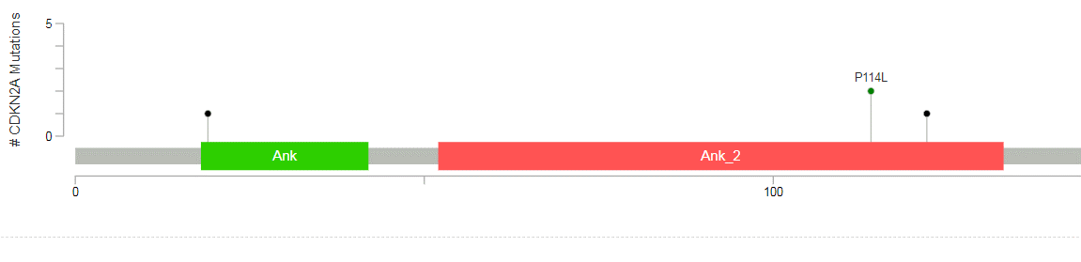
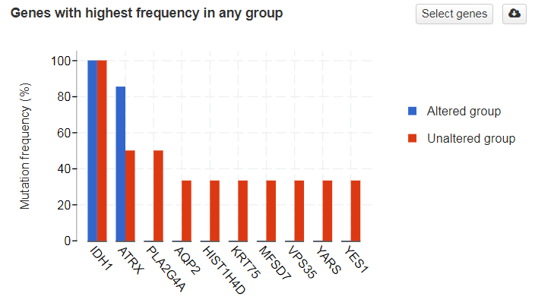

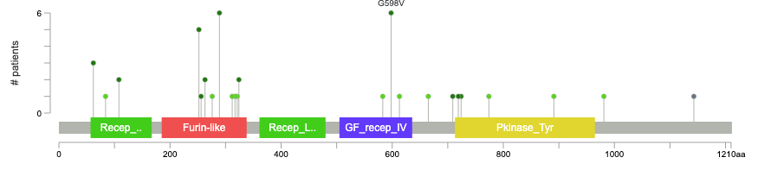
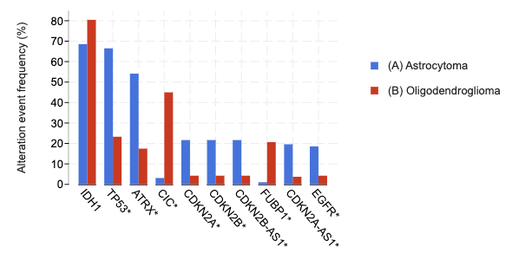
3. Gene Level
This study was funded by the Horizon Europe Twinning Project STEPUPIORS - 101079217

Slide 22

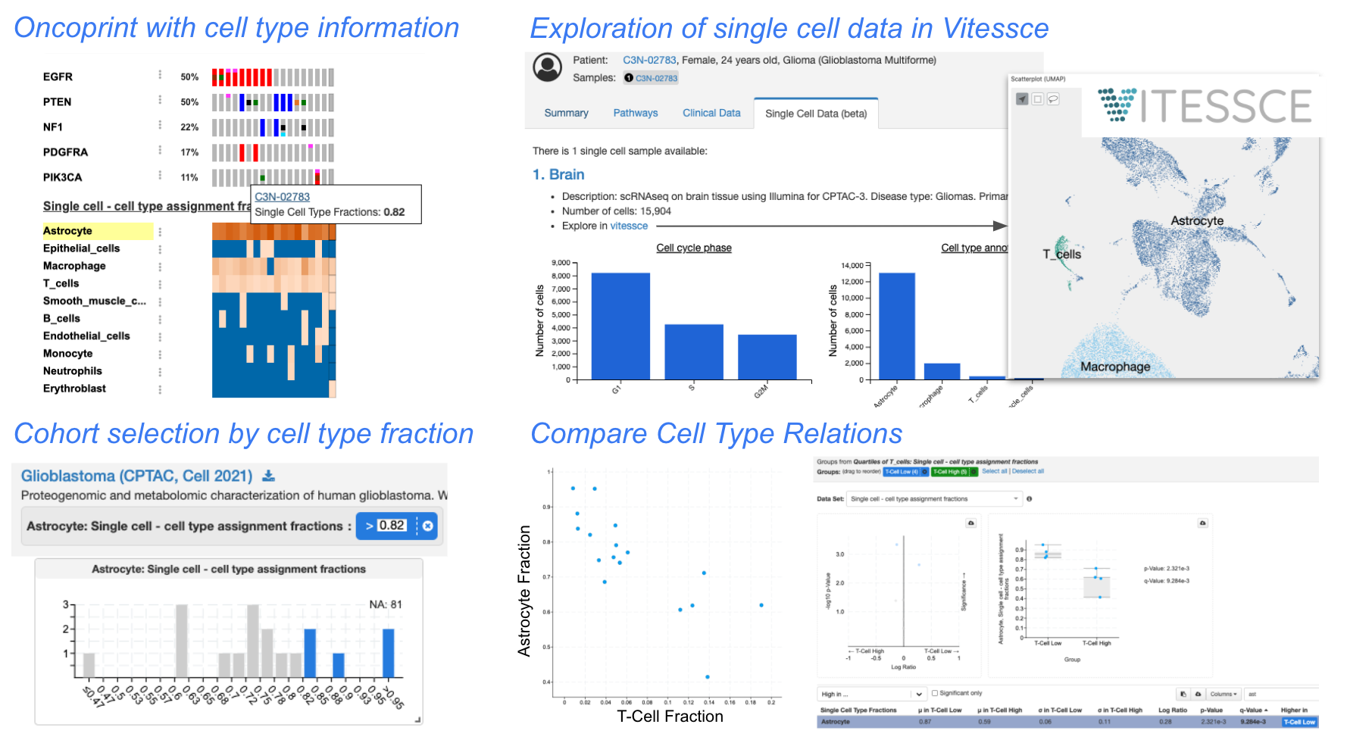
Inclusion of new features
New Feature: Several single cell data integrations are now available for the CPTAC glioblastoma study, allowing one to:
Compare genomic alterations and cell type fractions in oncoprints on the Results View (Example)
Explore the single cell data further in Vitessce on the Patient View (Example)
Create cohorts and groups based on cell type fractions on the Study View (Example)
Compare differences in cell type fractions between groups on the Comparison Page (Example)
Note: both cellxgene and Mira are other single cell viewers the cBioPortal team has set up some integration for other studies
This study was funded by the Horizon Europe Twinning Project STEPUPIORS - 101079217

Slide 23
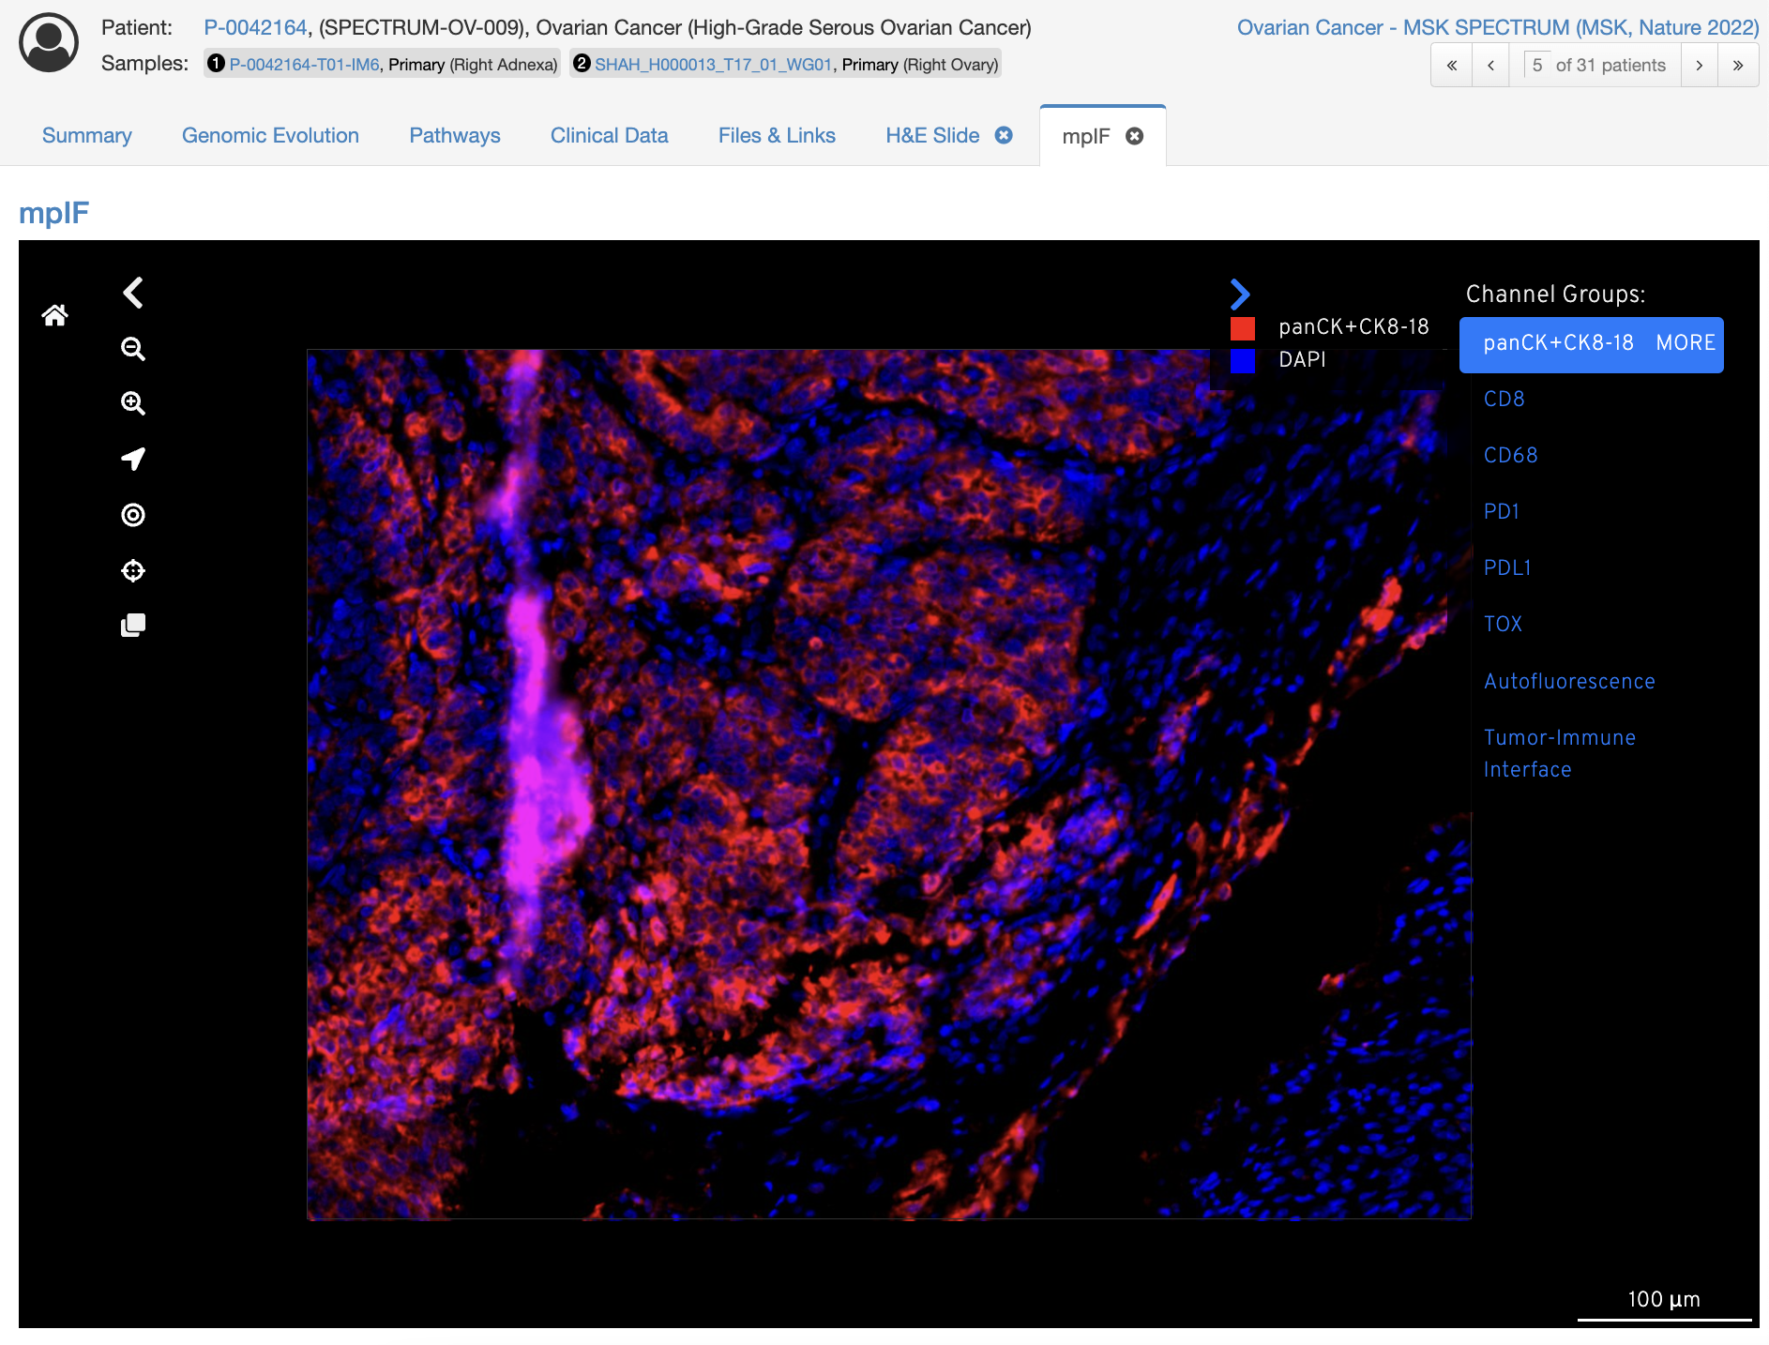
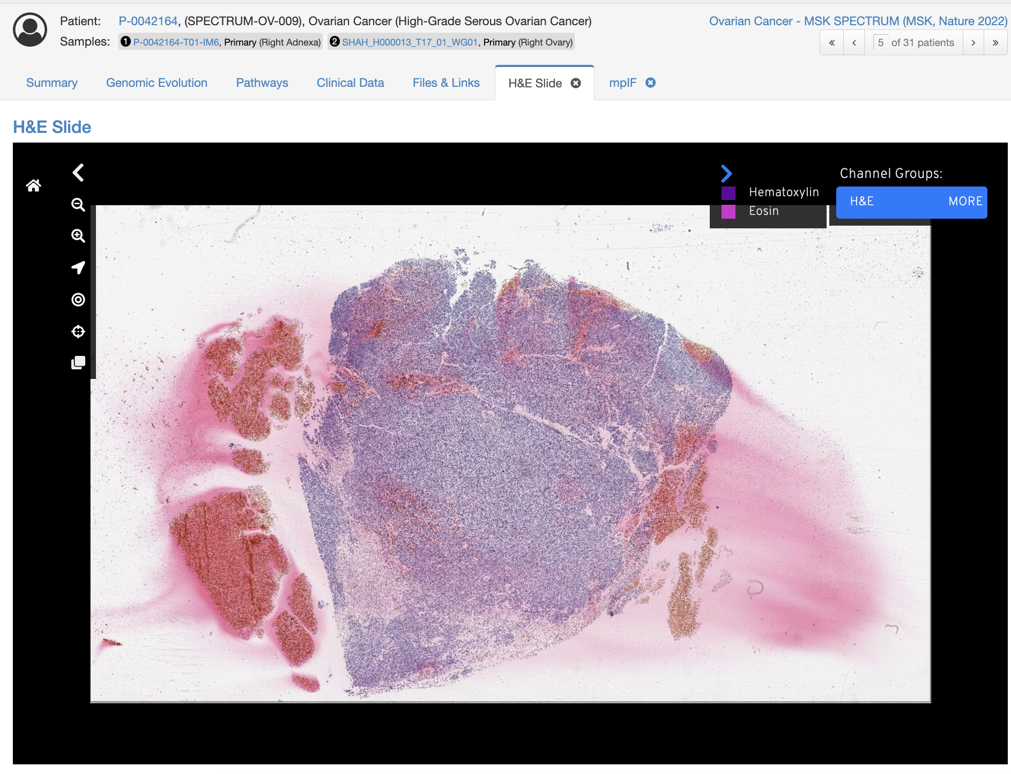
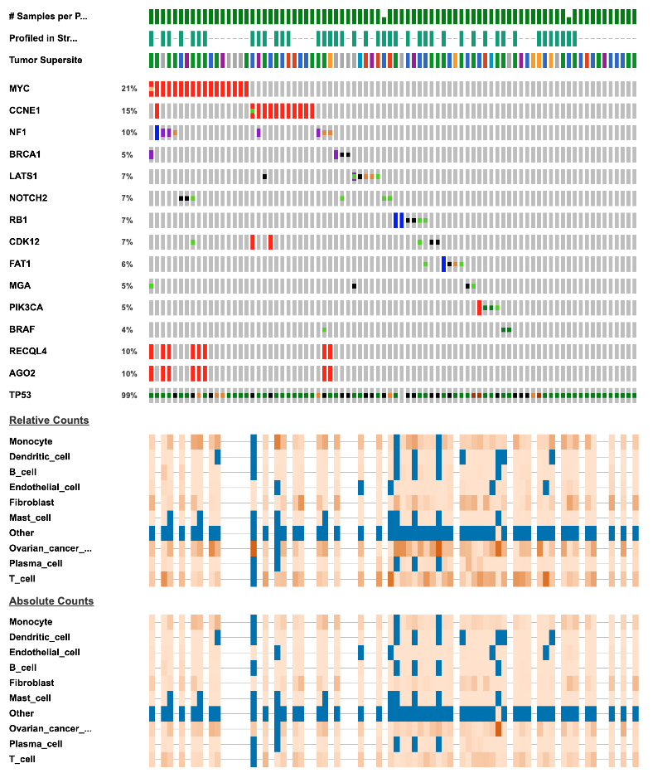
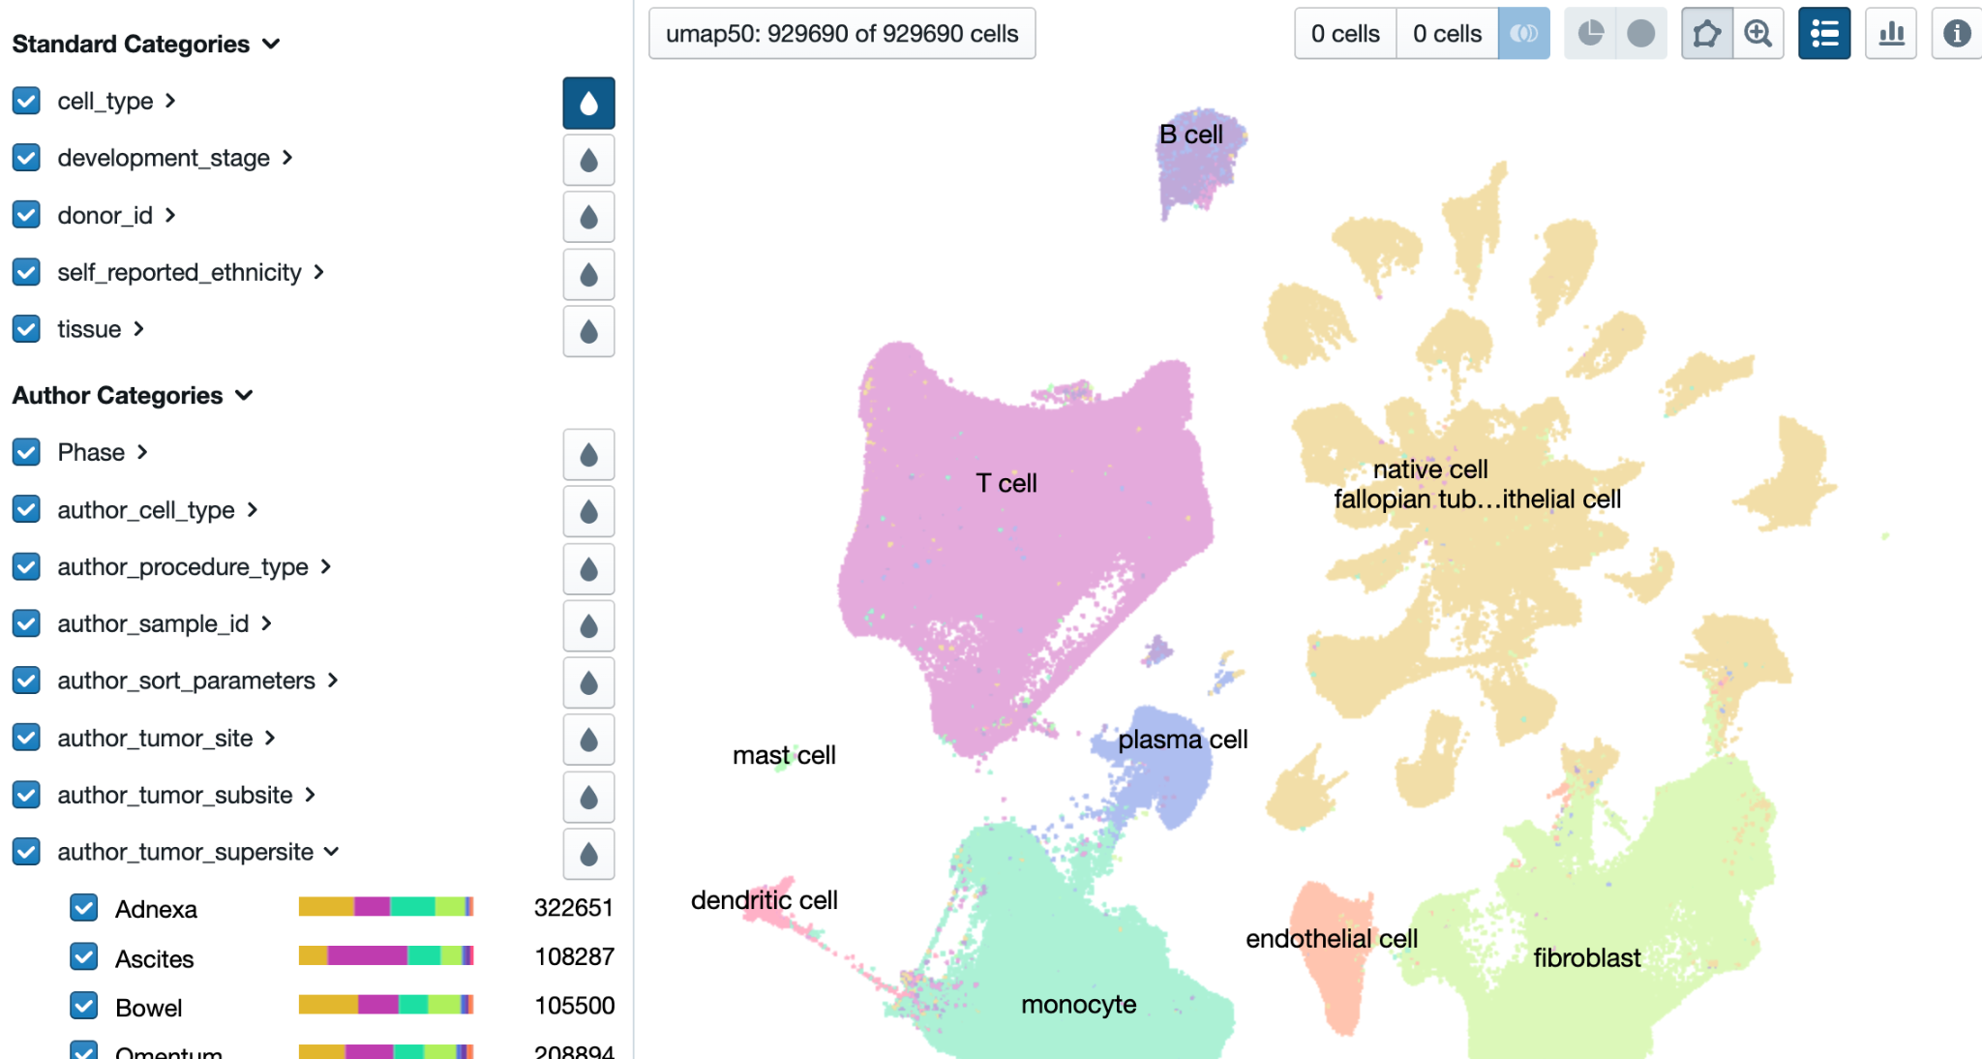
Inclusion of new features
Multiplex imaging and H&E
Oncoprints combining
WGS, MSK-IMPACT, scRNASeq
Integration with CellxGene
This study was funded by the Horizon Europe Twinning Project STEPUPIORS - 101079217

Slide 24
Cancer Data in cBioPortal
Data Capturing Platforms
Informed Consent
Clinical Characteristics
Imaging
Biosamples & Derivatives
Pathology
Molecular Profiling
PROMs
Patient Reported Outcome Measures
Very nice for the user! No bioinformatics experience is needed!
… once the data is actually *in* cBioPortal; definitely do need domain experts for prepping the data…
Integration, Analysis & Visualization
Clinical Interpretation
Explore the datasets on:
Study level with group comparison
Patient level
Gene level
Biological Discovery
This study was funded by the Horizon Europe Twinning Project STEPUPIORS - 101079217

Slide 25
Questions?
This study was funded by the Horizon Europe Twinning Project STEPUPIORS - 101079217

Slide 26




Acknowledgements
INSTITUTE FOR ONCOLOGY AND RADIOLOGY OF SERBIA
CONSORCI INSTITUT D'INVESTIGACIONS BIOMEDIQUES AUGUST PI I SUNYER
HOSPITAL CLINIC DE BARCELONA
THE NETHERLANDS CANCER INSTUTUTE ANTONI VAN LEEUWENHOEK
Biomedical Research Foundation Academy of Athens, greece
This study was funded by the Horizon Europe Twinning Project STEPUPIORS - 101079217

